Slide 1
Retinal Anatomy and Histology
What is the difference between the retina and the neurosensory retina?
While often used interchangeably (including, on occasion, in this slide-set), these are technically not synonyms. The term neurosensory retina refers to the neural lining on the inside of the eye, whereas the term retina refers to this neural lining along with the retinal pigment epithelium (RPE).

Slide 2
Retinal Anatomy and Histology
What is the difference between the retina and the neurosensory retina?
While often used interchangeably (including, on occasion, in this slide-set), these are technically not synonyms. The term neurosensory retina refers to the neural lining on the inside of the eye, whereas the term retina refers to this neural lining along with the retinal pigment epithelium (RPE).
The neurosensory retina contains three classes of cells: There are five types of neural elements—what are they? What are the three types of glial cells? The two vascular cell types?
--Neurons
----PRs
----Bipolar cells
----Ganglion cells
----Amacrine cells
----Horizontal cells
--Glial
----Müeller cells
----Astrocytes
----Microglia
--Vascular

Slide 3
Retinal Anatomy and Histology
What is the difference between the retina and the neurosensory retina?
While often used interchangeably (including, on occasion, in this slide-set), these are technically not synonyms. The term neurosensory retina refers to the neural lining on the inside of the eye, whereas the term retina refers to this neural lining along with the retinal pigment epithelium (RPE).
The neurosensory retina contains three classes of cells:
There are five types of neural elements: What are the three types of glial cells? The two vascular cell types?
--Neurons:
----Photoreceptors (PRs)
----Bipolar cells
----Ganglion cells
----Amacrine cells
----Horizontal cells
--Glial
----Müeller cells
----Astrocytes
----Microglia
--Vascular

Slide 4
Retinal Anatomy and Histology
What is the difference between the retina and the neurosensory retina?
While often used interchangeably (including, on occasion, in this slide-set), these are technically not synonyms. The term neurosensory retina refers to the neural lining on the inside of the eye, whereas the term retina refers to this neural lining along with the retinal pigment epithelium (RPE).
The neurosensory retina contains three classes of cells:
There are five types of neural elements:
Three types of glial cells: The two v
ascular cell types
--Neurons:
----Photoreceptors (PRs)
----Bipolar cells
----Ganglion cells
----Amacrine cells
----Horizontal cells
--Glial:
----Müeller cells
----Astrocytes
----Microglia
--Vascular

Slide 5
Retinal Anatomy and Histology
What is the difference between the retina and the neurosensory retina?
While often used interchangeably (including, on occasion, in this slide-set), these are technically not synonyms. The term neurosensory retina refers to the neural lining on the inside of the eye, whereas the term retina refers to this neural lining along with the retinal pigment epithelium (RPE).
The neurosensory retina contains three classes of cells:
There are five types of neural elements:
Three types of glial cells: The two v
ascular cell types
--Neurons:
----Photoreceptors (PRs)
----Bipolar cells
----Ganglion cells
----Amacrine cells
----Horizontal cells
--Glial:
----Müeller cells
----Astrocytes
----Microglia
--Vascular
One of the glial cells is of particular note—Müeller cells. These large cells extend the breadth of the neurosensory retina, and their foot-processes form the internal limiting membrane of the retina.

Slide 6
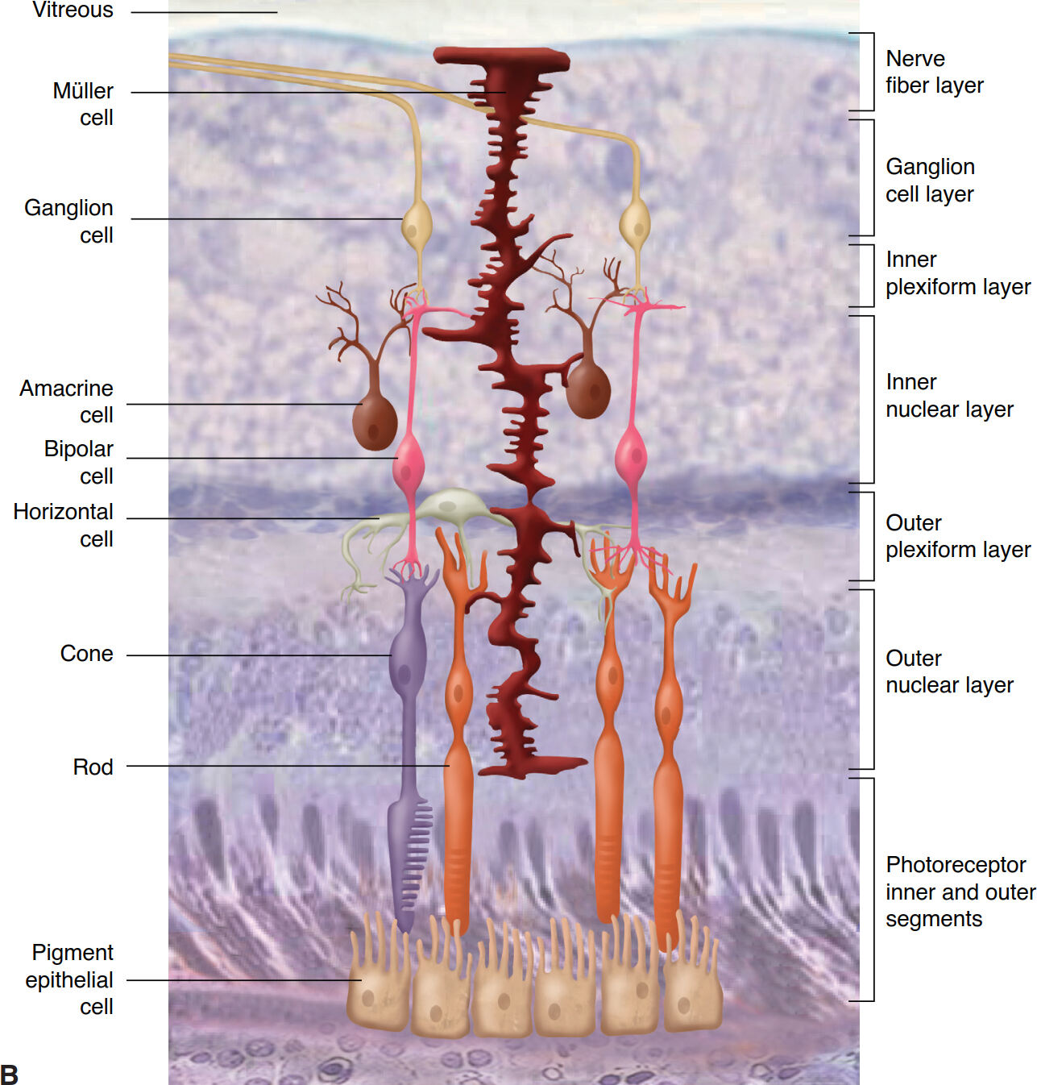
Retinal Anatomy and Histology
Müeller cells

Slide 7
Retinal Anatomy and Histology
What is the difference between the retina and the neurosensory retina?
While often used interchangeably (including, on occasion, in this slide-set), these are technically not synonyms. The term neurosensory retina refers to the neural lining on the inside of the eye, whereas the term retina refers to this neural lining along with the retinal pigment epithelium (RPE).
The neurosensory retina contains three classes of cells:
There are five types of neural elements:
Three types of glial cells:
And lastly, two vascular cell types:
--Neurons:
----Photoreceptors (PRs)
----Bipolar cells
----Ganglion cells
----Amacrine cells
----Horizontal cells
--Glial:
----Müeller cells
----Astrocytes
----Microglia
--Vascular:
----Endothelial cells
----Pericytes

Slide 8
Retinal Anatomy and Histology
What is the difference between the retina and the neurosensory retina?
While often used interchangeably (including, on occasion, in this slide-set), these are technically not synonyms. The term neurosensory retina refers to the neural lining on the inside of the eye, whereas the term retina refers to this neural lining along with the retinal pigment epithelium (RPE).
The neurosensory retina contains three classes of cells:
There are five types of neural elements:
Three types of glial cells:
And lastly, two vascular cell types:
--Neurons:
----Photoreceptors (PRs)
----Bipolar cells
----Ganglion cells
----Amacrine cells
----Horizontal cells
--Glial:
----Müeller cells
----Astrocytes
----Microglia
--Vascular:
----Endothelial cells
----Pericytes
The amacrine cells and horizontal cells are interneurons connecting other neural elements.

Slide 9
Retinal Anatomy and Histology
What is the difference between the retina and the neurosensory retina?
While often used interchangeably (including, on occasion, in this slide-set), these are technically not synonyms. The term neurosensory retina refers to the neural lining on the inside of the eye, whereas the term retina refers to this neural lining along with the retinal pigment epithelium (RPE).
The neurosensory retina contains three classes of cells:
There are five types of neural elements:
Three types of glial cells:
And lastly, two vascular cell types:
--Neurons:
----Photoreceptors (PRs)
----Bipolar cells
----Ganglion cells
----Amacrine cells
----Horizontal cells
--Glial:
----Müeller cells
----Astrocytes
----Microglia
--Vascular:
----Endothelial cells
----Pericytes
The amacrine cells and horizontal cells are interneurons connecting other neural elements. The horizontal cells interconnect PRs with one another; the amacrine cells interconnect bipolar cells, and ganglion cells.

Slide 10
Retinal Anatomy and Histology
What is the difference between the retina and the neurosensory retina?
While often used interchangeably (including, on occasion, in this slide-set), these are technically not synonyms. The term neurosensory retina refers to the neural lining on the inside of the eye, whereas the term retina refers to this neural lining along with the retinal pigment epithelium (RPE).
The neurosensory retina contains three classes of cells:
There are five types of neural elements:
Three types of glial cells:
And lastly, two vascular cell types:
--Neurons:
----Photoreceptors (PRs)
----Bipolar cells
----Ganglion cells
----Amacrine cells
----Horizontal cells
--Glial:
----Müeller cells
----Astrocytes
----Microglia
--Vascular:
----Endothelial cells
----Pericytes
Noting that amacrine and horizontal cells are interconnectors dovetails nicely with a fundamental way you should think about the neural elements of the neurosensory retina. Specifically, all of the neural elements can be conceptualized as belonging to one of two pathways:
--The vertical pathway comprised of (in order) the PRs, bipolar cells, and ganglion cells; and --the horizontal pathway comprised of amacrine and horizontal cells

Slide 11
Retinal Anatomy and Histology
What is the difference between the retina and the neurosensory retina?
While often used interchangeably (including, on occasion, in this slide-set), these are technically not synonyms. The term neurosensory retina refers to the neural lining on the inside of the eye, whereas the term retina refers to this neural lining along with the retinal pigment epithelium (RPE).
The neurosensory retina contains three classes of cells:
There are five types of neural elements:
Three types of glial cells:
And lastly, two vascular cell types:
--Neurons:
----Photoreceptors (PRs)
----Bipolar cells
----Ganglion cells
----Amacrine cells
----Horizontal cells
--Glial:
----Müeller cells
----Astrocytes
----Microglia
--Vascular:
----Endothelial cells
----Pericytes
Noting that amacrine and horizontal cells are interconnectors dovetails nicely with a fundamental way you should think about the neural elements of the neurosensory retina. Specifically, all of the neural elements can be conceptualized as belonging to one of two pathways:
--The vertical pathway comprised of (in order) the PRs, bipolar cells, and ganglion cells; and --the horizontal pathway comprised of amacrine and horizontal cells
Vertical
pathway
Horizontal
pathway

Slide 12
Retinal Anatomy and Histology
What is the difference between the retina and the neurosensory retina?
While often used interchangeably (including, on occasion, in this slide-set), these are technically not synonyms. The term neurosensory retina refers to the neural lining on the inside of the eye, whereas the term retina refers to this neural lining along with the retinal pigment epithelium (RPE).
The neurosensory retina contains three classes of cells:
There are five types of neural elements:
Three types of glial cells:
And lastly, two vascular cell types:
--Neurons:
----Photoreceptors (PRs)
----Bipolar cells
----Ganglion cells
----Amacrine cells
----Horizontal cells
--Glial:
----Müeller cells
----Astrocytes
----Microglia
--Vascular:
----Endothelial cells
----Pericytes
Noting that amacrine and horizontal cells are interconnectors dovetails nicely with a fundamental way you should think about the neural elements of the neurosensory retina. Specifically, all of the neural elements can be conceptualized as belonging to one of two pathways:
--The vertical pathway comprised of (in order) the PRs, bipolar cells, and ganglion cells; and --the horizontal pathway comprised of amacrine and horizontal cells
What does it mean to say the vertical pathway is, well, vertical?
It means that this is the direct path that neural impulses take in getting out of the eye and to the visual cortex.
Vertical
pathway
Horizontal
pathway

Slide 13
Retinal Anatomy and Histology
What is the difference between the retina and the neurosensory retina?
While often used interchangeably (including, on occasion, in this slide-set), these are technically not synonyms. The term neurosensory retina refers to the neural lining on the inside of the eye, whereas the term retina refers to this neural lining along with the retinal pigment epithelium (RPE).
The neurosensory retina contains three classes of cells:
There are five types of neural elements:
Three types of glial cells:
And lastly, two vascular cell types:
--Neurons:
----Photoreceptors (PRs)
----Bipolar cells
----Ganglion cells
----Amacrine cells
----Horizontal cells
--Glial:
----Müeller cells
----Astrocytes
----Microglia
--Vascular:
----Endothelial cells
----Pericytes
Noting that amacrine and horizontal cells are interconnectors dovetails nicely with a fundamental way you should think about the neural elements of the neurosensory retina. Specifically, all of the neural elements can be conceptualized as belonging to one of two pathways:
--The vertical pathway comprised of (in order) the PRs, bipolar cells, and ganglion cells; and --the horizontal pathway comprised of amacrine and horizontal cells
What does it mean to say the vertical pathway is, well, vertical?
It means that this is the direct path that neural impulses take in getting out of the eye and to the visual cortex.
Vertical
pathway
Horizontal
pathway
In contrast, the horizontal pathway conducts impulses from one area of the retina to another.

Slide 14
Retinal Anatomy and Histology
What is the difference between the retina and the neurosensory retina?
While often used interchangeably (including, on occasion, in this slide-set), these are technically not synonyms. The term neurosensory retina refers to the neural lining on the inside of the eye, whereas the term retina refers to this neural lining along with the retinal pigment epithelium (RPE).
The neurosensory retina contains three classes of cells:
There are five types of neural elements:
Three types of glial cells:
And lastly, two vascular cell types:
--Neurons:
----Photoreceptors (PRs)
----Bipolar cells
----Ganglion cells
----Amacrine cells
----Horizontal cells
--Glial:
----Müeller cells
----Astrocytes
----Microglia
--Vascular:
----Endothelial cells
----Pericytes
Let’s drill down on the PRs. Their fundamental role is to convert light energy into electrical (neural) impulses, ie, they are the site at which phototransduction occurs. There are two basic PR types: Rods and cones, each named for the shape of their outer segments (we’ll explain what an outer seg is shortly). In the average human retina there are 100-125M rods, and 6-7M cones.
Rods and cones differ in many ways, but the most fundamental is that cones provide color vision, whereas rods provide monochromatic vision. There are three types of cones; they differ in terms of the wavelength of light to which they are most responsive: Short wavelength (S cones), medium (M cones), and long (L cones).

Slide 15
Retinal Anatomy and Histology
What is the difference between the retina and the neurosensory retina?
While often used interchangeably (including, on occasion, in this slide-set), these are technically not synonyms. The term neurosensory retina refers to the neural lining on the inside of the eye, whereas the term retina refers to this neural lining along with the retinal pigment epithelium (RPE).
The neurosensory retina contains three classes of cells:
There are five types of neural elements:
Three types of glial cells:
And lastly, two vascular cell types:
--Neurons:
----Photoreceptors (PRs)
----Bipolar cells
----Ganglion cells
----Amacrine cells
----Horizontal cells
--Glial:
----Müeller cells
----Astrocytes
----Microglia
--Vascular:
----Endothelial cells
----Pericytes
Let’s drill down on the PRs. Their fundamental role is to convert light energy into electrical (neural) impulses, ie, they are the site at which phototransduction occurs. There are two basic PR types: Rods and cones, each named for the shape of their outer segments (we’ll explain what an outer seg is shortly). In the average human retina there are 100-125M rods, and 6-7M cones.
Rods and cones differ in many ways, but the most fundamental is that cones provide color vision, whereas rods provide monochromatic vision. There are three types of cones; they differ in terms of the wavelength of light to which they are most responsive: Short wavelength (S cones), medium (M cones), and long (L cones).

Slide 16
Retinal Anatomy and Histology
What is the difference between the retina and the neurosensory retina?
While often used interchangeably (including, on occasion, in this slide-set), these are technically not synonyms. The term neurosensory retina refers to the neural lining on the inside of the eye, whereas the term retina refers to this neural lining along with the retinal pigment epithelium (RPE).
The neurosensory retina contains three classes of cells:
There are five types of neural elements:
Three types of glial cells:
And lastly, two vascular cell types:
--Neurons:
----Photoreceptors (PRs)
----Bipolar cells
----Ganglion cells
----Amacrine cells
----Horizontal cells
--Glial:
----Müeller cells
----Astrocytes
----Microglia
--Vascular:
----Endothelial cells
----Pericytes
Let’s talk PR morphology. PRs have several portions, one being the outer segment (outer means ‘closer to the eye wall’). As mentioned, the outer segs of rods and cones are rod-shaped and conical, respectively.
The dominant morphologic feature of a PR outer seg are its discs. The disc membranes contain the protein rhodopsin, which is the substance that reacts to the incoming light and kicks off the process of phototransduction. After a disc’s phototransduction ability is spent, it is ‘shed’ by the PR, and gobbled up by adjacent RPE cells. The apical aspects of the PRs interdigitate intimately with the highly convoluted apical aspects of the RPE. The interdigitation between the PR outer segs and the RPE involves no direct connections between them. This is important because it means a potential space exists between the PRs and RPE, and it is this space that opens up in a retinal detachment.

Slide 17
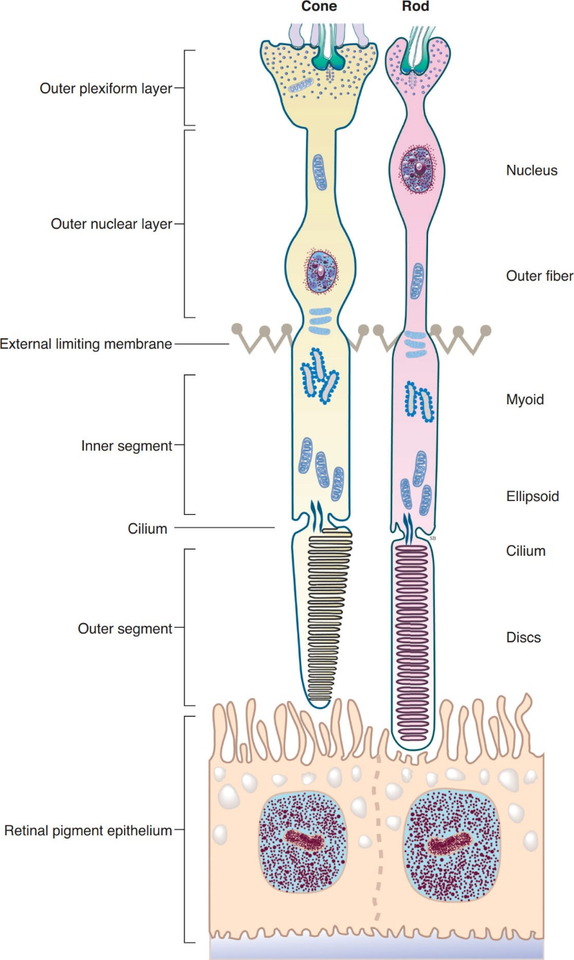
Retinal Anatomy and Histology
Synaptic processes
Cell body

Slide 18
Retinal Anatomy and Histology
What is the difference between the retina and the neurosensory retina?
While often used interchangeably (including, on occasion, in this slide-set), these are technically not synonyms. The term neurosensory retina refers to the neural lining on the inside of the eye, whereas the term retina refers to this neural lining along with the retinal pigment epithelium (RPE).
The neurosensory retina contains three classes of cells:
There are five types of neural elements:
Three types of glial cells:
And lastly, two vascular cell types:
--Neurons:
----Photoreceptors (PRs)
----Bipolar cells
----Ganglion cells
----Amacrine cells
----Horizontal cells
--Glial:
----Müeller cells
----Astrocytes
----Microglia
--Vascular:
----Endothelial cells
----Pericytes
Let’s talk PR morphology. PRs have several portions, one being the outer segment (outer means ‘closer to the eye wall’). As mentioned, the outer segs of rods and cones are rod-shaped and conical, respectively.
The dominant morphologic feature of a PR outer seg are its discs. The disc membranes contain the protein rhodopsin, which is the substance that reacts to the incoming light and kicks off the process of phototransduction. After a disc’s phototransduction ability is spent, it is ‘shed’ by the PR, and gobbled up by adjacent RPE cells. The apical aspects of the PRs interdigitate intimately with the highly convoluted apical aspects of the RPE. The interdigitation between the PR outer segs and the RPE involves no direct connections between them. This is important because it means a potential space exists between the PRs and RPE, and it is this space that opens up in a retinal detachment.

Slide 19
Retinal Anatomy and Histology
Synaptic processes
Cell body

Slide 20
Retinal Anatomy and Histology
What is the difference between the retina and the neurosensory retina?
While often used interchangeably (including, on occasion, in this slide-set), these are technically not synonyms. The term neurosensory retina refers to the neural lining on the inside of the eye, whereas the term retina refers to this neural lining along with the retinal pigment epithelium (RPE).
The neurosensory retina contains three classes of cells:
There are five types of neural elements:
Three types of glial cells:
And lastly, two vascular cell types:
--Neurons:
----Photoreceptors (PRs)
----Bipolar cells
----Ganglion cells
----Amacrine cells
----Horizontal cells
--Glial:
----Müeller cells
----Astrocytes
----Microglia
--Vascular:
----Endothelial cells
----Pericytes
Let’s talk PR morphology. PRs have several portions, one being the outer segment (outer means ‘closer to the eye wall’). As mentioned, the outer segs of rods and cones are rod-shaped and conical, respectively.
The dominant morphologic feature of a PR outer seg are its discs. The disc membranes contain the protein rhodopsin, which is the substance that reacts to the incoming light and kicks off the process of phototransduction. After a disc’s phototransduction ability is spent, it is ‘shed’ by the PR, and gobbled up by adjacent RPE cells. The apical aspects of the PRs interdigitate intimately with the highly convoluted apical aspects of the RPE. The interdigitation between the PR outer segs and the RPE involves no direct connections between them. This is important because it means a potential space exists between the PRs and RPE, and it is this space that opens up in a retinal detachment.

Slide 21
Retinal Anatomy and Histology
What is the difference between the retina and the neurosensory retina?
While often used interchangeably (including, on occasion, in this slide-set), these are technically not synonyms. The term neurosensory retina refers to the neural lining on the inside of the eye, whereas the term retina refers to this neural lining along with the retinal pigment epithelium (RPE).
The neurosensory retina contains three classes of cells:
There are five types of neural elements:
Three types of glial cells:
And lastly, two vascular cell types:
--Neurons:
----Photoreceptors (PRs)
----Bipolar cells
----Ganglion cells
----Amacrine cells
----Horizontal cells
--Glial:
----Müeller cells
----Astrocytes
----Microglia
--Vascular:
----Endothelial cells
----Pericytes
Next to the outer segment is, perhaps not surprisingly, the inner segment. The inner and outer segments are connected by a nonmotile cilium. Disorders affecting the integrity of the cilia have enormous consequences for PR/retinal health and visual function, as they can produce a retinitis pigmentosa-like clinical picture.
The inner segment has two subsections—an ellipsoid immediately adjacent to the cilium, then a myoid. Each area is known for its contents, with the ellipsoid being chock full of mitochondria, and the myoid full of glycogen.

Slide 22
Retinal Anatomy and Histology
Synaptic processes
Cell body

Slide 23
Retinal Anatomy and Histology
What is the difference between the retina and the neurosensory retina?
While often used interchangeably (including, on occasion, in this slide-set), these are technically not synonyms. The term neurosensory retina refers to the neural lining on the inside of the eye, whereas the term retina refers to this neural lining along with the retinal pigment epithelium (RPE).
The neurosensory retina contains three classes of cells:
There are five types of neural elements:
Three types of glial cells:
And lastly, two vascular cell types:
--Neurons:
----Photoreceptors (PRs)
----Bipolar cells
----Ganglion cells
----Amacrine cells
----Horizontal cells
--Glial:
----Müeller cells
----Astrocytes
----Microglia
--Vascular:
----Endothelial cells
----Pericytes
Next to the outer segment is, perhaps not surprisingly, the inner segment. The inner and outer segments are connected by a nonmotile cilium. Disorders affecting the integrity of the cilia have enormous consequences for PR/retinal health and visual function, as they can produce a retinitis pigmentosa-like clinical picture.
The inner segment has two subsections—an ellipsoid immediately adjacent to the cilium, then a myoid. Each area is known for its contents, with the ellipsoid being chock full of mitochondria, and the myoid full of glycogen.

Slide 24
Retinal Anatomy and Histology
Synaptic processes
Cell body

Slide 25
Retinal Anatomy and Histology
What is the difference between the retina and the neurosensory retina?
While often used interchangeably (including, on occasion, in this slide-set), these are technically not synonyms. The term neurosensory retina refers to the neural lining on the inside of the eye, whereas the term retina refers to this neural lining along with the retinal pigment epithelium (RPE).
The neurosensory retina contains three classes of cells:
There are five types of neural elements:
Three types of glial cells:
And lastly, two vascular cell types:
--Neurons:
----Photoreceptors (PRs)
----Bipolar cells
----Ganglion cells
----Amacrine cells
----Horizontal cells
--Glial:
----Müeller cells
----Astrocytes
----Microglia
--Vascular:
----Endothelial cells
----Pericytes
Next to the outer segment is, perhaps not surprisingly, the inner segment. The inner and outer segments are connected by a nonmotile cilium. Disorders affecting the integrity of the cilia have enormous consequences for PR/retinal health and visual function, as they can produce a retinitis pigmentosa-like clinical picture.
The inner segment has two subsections—an ellipsoid immediately adjacent to the cilium, then a myoid. Each area is known for its contents, with the ellipsoid being chock full of mitochondria, and the myoid full of glycogen.

Slide 26
Retinal Anatomy and Histology
Synaptic processes
Cell body

Slide 27
Retinal Anatomy and Histology
What is the difference between the retina and the neurosensory retina?
While often used interchangeably (including, on occasion, in this slide-set), these are technically not synonyms. The term neurosensory retina refers to the neural lining on the inside of the eye, whereas the term retina refers to this neural lining along with the retinal pigment epithelium (RPE).
The neurosensory retina contains three classes of cells:
There are five types of neural elements:
Three types of glial cells:
And lastly, two vascular cell types:
--Neurons:
----Photoreceptors (PRs)
----Bipolar cells
----Ganglion cells
----Amacrine cells
----Horizontal cells
--Glial:
----Müeller cells
----Astrocytes
----Microglia
--Vascular:
----Endothelial cells
----Pericytes
Continuing on…The portion of the PR next to the inner segment is the cell body, which houses the cell’s nucleus.
While not a part of the PRs per se, they (the PRs) contribute to an important retinal structure located at the juncture of the inner segment and cell body—the external limiting membrane (ELM). The ELM is not an actual membrane, rather, it is a barrier created by connections between Mueller cells and PRs.
After the cell body, the final portion of the PR is an axon-like fiber terminating in the PR’s synaptic processes.

Slide 28
Retinal Anatomy and Histology
Synaptic processes
Cell body

Slide 29
Retinal Anatomy and Histology
What is the difference between the retina and the neurosensory retina?
While often used interchangeably (including, on occasion, in this slide-set), these are technically not synonyms. The term neurosensory retina refers to the neural lining on the inside of the eye, whereas the term retina refers to this neural lining along with the retinal pigment epithelium (RPE).
The neurosensory retina contains three classes of cells:
There are five types of neural elements:
Three types of glial cells:
And lastly, two vascular cell types:
--Neurons:
----Photoreceptors (PRs)
----Bipolar cells
----Ganglion cells
----Amacrine cells
----Horizontal cells
--Glial:
----Müeller cells
----Astrocytes
----Microglia
--Vascular:
----Endothelial cells
----Pericytes
Continuing on…The portion of the PR next to the inner segment is the cell body, which houses the cell’s nucleus.
While not a part of the PRs per se, they (the PRs) contribute to an important retinal structure located at the juncture of the inner segment and cell body—the external limiting membrane (ELM). The ELM is not an actual membrane, rather, it is a barrier created by connections between Mueller cells and PRs.
After the cell body, the final portion of the PR is an axon-like fiber terminating in the PR’s synaptic processes.

Slide 30
Retinal Anatomy and Histology
Synaptic processes
Cell body

Slide 31
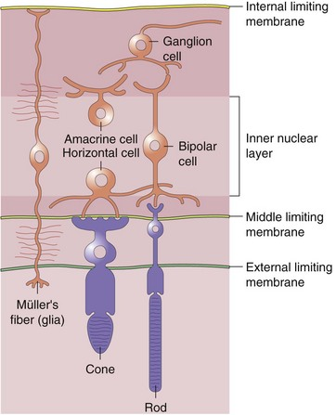
Retinal Anatomy and Histology
ELM, Müeller cells and PRs

Slide 32
Retinal Anatomy and Histology
What is the difference between the retina and the neurosensory retina?
While often used interchangeably (including, on occasion, in this slide-set), these are technically not synonyms. The term neurosensory retina refers to the neural lining on the inside of the eye, whereas the term retina refers to this neural lining along with the retinal pigment epithelium (RPE).
The neurosensory retina contains three classes of cells:
There are five types of neural elements:
Three types of glial cells:
And lastly, two vascular cell types:
--Neurons:
----Photoreceptors (PRs)
----Bipolar cells
----Ganglion cells
----Amacrine cells
----Horizontal cells
--Glial:
----Müeller cells
----Astrocytes
----Microglia
--Vascular:
----Endothelial cells
----Pericytes
Continuing on…The portion of the PR next to the inner segment is the cell body, which houses the cell’s nucleus.
While not a part of the PRs per se, they (the PRs) contribute to an important retinal structure located at the juncture of the inner segment and cell body—the external limiting membrane (ELM). The ELM is not an actual membrane, rather, it is a barrier created by connections between Mueller cells and PRs.
After the cell body, the final portion of the PR is an axon-like fiber terminating in the PR’s synaptic processes.

Slide 33
Retinal Anatomy and Histology
Synaptic processes
Cell body

Slide 34
Retinal Anatomy and Histology
Next we will look at the layers of the neurosensory retina. But before we do, let’s make sure you’re on fleek* regarding the critical aspects of retinal histology we’ve seen thus far.
*You’re so cool, Dr Flynn

Slide 35
Retinal Anatomy and Histology
Next we will look at the layers of the neurosensory retina. But before we do, let’s make sure you’re on fleek* regarding the critical aspects of retinal histology we’ve seen thus far. Why? Because as we will see later in the slide-set, a firm grasp of this info is absolutely required to read OCTs. So go through the next section of slides over and over until they’re burned into your brain. (You’ll thank me later.)
*You’re so cool, Dr Flynn

Slide 36
Retinal Anatomy and Histology
Synaptic processes
Cell body
Working out→in: The first structure to be particularly aware of is…
RPE/Bruch’s membrane complex

Slide 37
Retinal Anatomy and Histology
Synaptic processes
Cell body
The next is…
The interdigitation zone
RPE/Bruch’s membrane complex

Slide 38
Retinal Anatomy and Histology
Synaptic processes
Cell body
The next is…
PR outer segs
The interdigitation zone
RPE/Bruch’s membrane complex

Slide 39
Retinal Anatomy and Histology
Synaptic processes
Cell body
The next is…
The ellipsoid zone
PR outer segs
The interdigitation zone
RPE/Bruch’s membrane complex

Slide 40
Retinal Anatomy and Histology
Synaptic processes
Cell body
The next is…
The myoid zone
The ellipsoid zone
PR outer segs
The interdigitation zone
RPE/Bruch’s membrane complex

Slide 41
Retinal Anatomy and Histology
Synaptic processes
Cell body
And the last is…
The ELM
The myoid zone
The ellipsoid zone
PR outer segs
The interdigitation zone
RPE/Bruch’s membrane complex

Slide 42
Retinal Anatomy and Histology
Synaptic processes
Re-rack those until you know them cold!
Cell body
The ELM
The myoid zone
The ellipsoid zone
PR outer segs
The interdigitation zone
RPE/Bruch’s membrane complex

Slide 43
Retinal Anatomy and Histology
Now we’re ready to review the layers of the retina

Slide 44
Retinal Anatomy and Histology
Neurosensory Retina Layers
  Internal limiting membrane
  Nerve fiber layer
  Ganglion cell layer
  Inner plexiform layer
  Inner nuclear layer
  Outer plexiform layer
  Outer nuclear layer
  External limiting membrane
  Rod & cone inner and outer segments
RPE
Bruch’s membrane
Here they are, but don’t try to memorize them at this point—instead, let’s work through them.

Slide 45
Retinal Anatomy and Histology
Neurosensory Retina Layers
  Internal limiting membrane
  Nerve fiber layer
  Ganglion cell layer
  Inner plexiform layer
  Inner nuclear layer
  Outer plexiform layer
  Outer nuclear layer
  External limiting membrane
  Rod & cone inner and outer segments
RPE
Bruch’s membrane
These three layers consist of fibers, ie, axons and/or dendrites. (A plexus is an interlaced group of fibers.)

Slide 46
Retinal Anatomy and Histology
Neurosensory Retina Layers
  Internal limiting membrane
  Nerve fiber layer
  Ganglion cell layer
  Inner plexiform layer
  Inner nuclear layer
  Outer plexiform layer
  Outer nuclear layer
  External limiting membrane
  Rod & cone inner and outer segments
RPE
Bruch’s membrane
In contrast, these layers composed of the cell bodies that give rise to the axons and/or dendrites of the other layers.

Slide 47
Retinal Anatomy and Histology
Neurosensory Retina Layers
  Internal limiting membrane
  Nerve fiber layer Processes
  Ganglion cell layer Bodies
  Inner plexiform layer Processes
  Inner nuclear layer Bodies
  Outer plexiform layer Processes
  Outer nuclear layer Bodies
  External limiting membrane
  Rod & cone inner and outer segments
RPE
Bruch’s membrane
Note that this section of the retina consists of
alternating layers of cell processes and cell bodies. This pattern can help you remember which layer is next to which!

Slide 48
Retinal Anatomy and Histology
Neurosensory Retina Layers
  Internal limiting membrane
  Nerve fiber layer Processes
  Ganglion cell layer Bodies
  Inner plexiform layer Processes
  Inner nuclear layer Bodies
  Outer plexiform layer Processes
  Outer nuclear layer Bodies
  External limiting membrane
  Rod & cone inner and outer segments
RPE
Bruch’s membrane
Axons
Dendrites
Axons
Dendrites
Axons
Further, we can see the origins of the fibers that comprise each fiber/plexiform layer

Slide 49
‘Nerve fiber layer’
Ganglion-cell axons
Neurosensory Retina Layers
  Internal limiting membrane
  Nerve fiber layer Processes
  Ganglion cell layer Bodies
  Inner plexiform layer Processes
  Inner nuclear layer Bodies
  Outer plexiform layer Processes
  Outer nuclear layer Bodies
  External limiting membrane
  Rod & cone inner and outer segments
RPE
Bruch’s membrane
Ganglion cells
The first layer after the ILM is the retinal nerve fiber layer. The NFL is composed of the axons of the ganglion cells. The cell bodies of the ganglion cells are located in the ganglion cell layer.
The NFL fibers run toward the lamina cribrosa of the sclera where they exit the eye, in the process forming first the optic nerve head, and then the optic nerve. Most of these fibers will synapse in the lateral geniculate nucleus (LGN); others will synapse elsewhere as part of the pupillary light reflex or circadian rhythm modulation.
Dendrites
Axons

Slide 50
‘Nerve fiber layer’
Ganglion-cell axons
Neurosensory Retina Layers
  Internal limiting membrane
  Nerve fiber layer Processes
  Ganglion cell layer Bodies
  Inner plexiform layer Processes
  Inner nuclear layer Bodies
  Outer plexiform layer Processes
  Outer nuclear layer Bodies
  External limiting membrane
  Rod & cone inner and outer segments
RPE
Bruch’s membrane
Ganglion cells
(in GCL)
The first layer after the ILM is the retinal nerve fiber layer. The NFL is composed of the axons of the ganglion cells. The cell bodies of the ganglion cells are located in the ganglion cell layer.
The NFL fibers run toward the lamina cribrosa of the sclera where they exit the eye, in the process forming first the optic nerve head, and then the optic nerve. Most of these fibers will synapse in the lateral geniculate nucleus (LGN); others will synapse elsewhere as part of the pupillary light reflex or circadian rhythm modulation.
Dendrites
Axons

Slide 51
‘Nerve fiber layer’
Ganglion-cell axons
Neurosensory Retina Layers
  Internal limiting membrane
  Nerve fiber layer Processes
  Ganglion cell layer Bodies
  Inner plexiform layer Processes
  Inner nuclear layer Bodies
  Outer plexiform layer Processes
  Outer nuclear layer Bodies
  External limiting membrane
  Rod & cone inner and outer segments
RPE
Bruch’s membrane
Ganglion cells
(in GCL)
The first layer after the ILM is the retinal nerve fiber layer. The NFL is composed of the axons of the ganglion cells. The cell bodies of the ganglion cells are located in the ganglion cell layer.
The NFL fibers run toward the lamina cribrosa of the sclera where they exit the eye, in the process forming first the optic nerve head, and then the optic nerve. Most of these fibers will synapse in the lateral geniculate nucleus (LGN); others will synapse elsewhere as part of the pupillary light reflex or circadian rhythm modulation.
Dendrites
Axons

Slide 52
To CNS
‘Nerve fiber layer’
Ganglion-cell axons
Neurosensory Retina Layers
  Internal limiting membrane
  Nerve fiber layer Processes
  Ganglion cell layer Bodies
  Inner plexiform layer Processes
  Inner nuclear layer Bodies
  Outer plexiform layer Processes
  Outer nuclear layer Bodies
  External limiting membrane
  Rod & cone inner and outer segments
RPE
Bruch’s membrane
Ganglion cells
(in GCL)
The first layer after the ILM is the retinal nerve fiber layer. The NFL is composed of the axons of the ganglion cells. The cell bodies of the ganglion cells are located in the ganglion cell layer.
The NFL fibers run toward the lamina cribrosa of the sclera where they exit the eye, in the process forming first the optic nerve head, and then the optic nerve. Most of these fibers will synapse in the lateral geniculate nucleus (LGN); others will synapse elsewhere as part of the pupillary light reflex or circadian rhythm modulation.

Slide 53
To CNS
‘Nerve fiber layer’
Ganglion-cell axons
Neurosensory Retina Layers
  Internal limiting membrane
  Nerve fiber layer Processes
  Ganglion cell layer Bodies
  Inner plexiform layer Processes
  Inner nuclear layer Bodies
  Outer plexiform layer Processes
  Outer nuclear layer Bodies
  External limiting membrane
  Rod & cone inner and outer segments
RPE
Bruch’s membrane
Ganglion cells
(in GCL)
Ganglion-cell dendrites
IPL
Bipolar-cell axons
The inner plexiform layer consists of connections between the dendrites of the ganglion cells as they synapse with axons originating from bipolar cells. The bodies of these bipolar cells reside in the inner nuclear layer.
Bipolar cells
Bipolar-cell dendrites

Slide 54
To CNS
‘Nerve fiber layer’
Ganglion-cell axons
Neurosensory Retina Layers
  Internal limiting membrane
  Nerve fiber layer Processes
  Ganglion cell layer Bodies
  Inner plexiform layer Processes
  Inner nuclear layer Bodies
  Outer plexiform layer Processes
  Outer nuclear layer Bodies
  External limiting membrane
  Rod & cone inner and outer segments
RPE
Bruch’s membrane
Ganglion cells
(in GCL)
Ganglion-cell dendrites
IPL
Bipolar-cell axons
The inner plexiform layer consists of connections between the dendrites of the ganglion cells as they synapse with axons originating from bipolar cells. The bodies of these bipolar cells reside in the inner nuclear layer.
Bipolar cells
(in INL)
Bipolar-cell dendrites

Slide 55
To CNS
‘Nerve fiber layer’
Ganglion-cell axons
Neurosensory Retina Layers
  Internal limiting membrane
  Nerve fiber layer Processes
  Ganglion cell layer Bodies
  Inner plexiform layer Processes
  Inner nuclear layer Bodies
  Outer plexiform layer Processes
  Outer nuclear layer Bodies
  External limiting membrane
  Rod & cone inner and outer segments
RPE
Bruch’s membrane
Ganglion cells
(in GCL)
Ganglion-cell dendrites
IPL
Bipolar-cell axons
Bipolar cells
(in INL)
Bipolar-cell dendrites
OPL
The outer plexiform layer consists of connections between the dendrites of the bipolar cells as they synapse with axons originating from the PRs. The cell bodies of the PRs reside in the outer nuclear layer.
PR axons

Slide 56
To CNS
‘Nerve fiber layer’
Ganglion-cell axons
Neurosensory Retina Layers
  Internal limiting membrane
  Nerve fiber layer Processes
  Ganglion cell layer Bodies
  Inner plexiform layer Processes
  Inner nuclear layer Bodies
  Outer plexiform layer Processes
  Outer nuclear layer Bodies
  External limiting membrane
  Rod & cone inner and outer segments
RPE
Bruch’s membrane
Ganglion cells
(in GCL)
Ganglion-cell dendrites
IPL
Bipolar-cell axons
Bipolar cells
(in INL)
Bipolar-cell dendrites
OPL
The outer plexiform layer consists of connections between the dendrites of the bipolar cells as they synapse with axons originating from the PRs. The cell bodies of the PRs reside in the outer nuclear layer.
PR axons
Photoreceptors
(cell bodies in ONL)

Slide 57
To CNS
‘Nerve fiber layer’
Ganglion-cell axons
Neurosensory Retina Layers
  Internal limiting membrane
  Nerve fiber layer Processes
  Ganglion cell layer Bodies
  Inner plexiform layer Processes
  Inner nuclear layer Bodies
  Outer plexiform layer Processes
  Outer nuclear layer Bodies
  External limiting membrane
  Rod & cone inner and outer segments
RPE
Bruch’s membrane
Ganglion cells
(in GCL)
Ganglion-cell dendrites
IPL
Bipolar-cell axons
Bipolar cells
(in INL)
Bipolar-cell dendrites
OPL
PR axons
Photoreceptors
(cell bodies in ONL)
(We’ve already covered at length the ELM, as well as the PR inner and outer segs)

Slide 58
To CNS
‘Nerve fiber layer’
Ganglion-cell axons
Neurosensory Retina Layers
  Internal limiting membrane
  Nerve fiber layer Processes
  Ganglion cell layer Bodies
  Inner plexiform layer Processes
  Inner nuclear layer Bodies
  Outer plexiform layer Processes
  Outer nuclear layer Bodies
  External limiting membrane
  Rod & cone inner and outer segments
RPE
Bruch’s membrane
Ganglion cells
(in GCL)
Ganglion-cell dendrites
IPL
Bipolar-cell axons
Bipolar cells
(in INL)
Bipolar-cell dendrites
OPL
PR axons
Photoreceptors
(cell bodies in ONL)
We’ll look at the RPE and Bruch’s in-depth shortly

Slide 59
To CNS
‘Nerve fiber layer’
Ganglion-cell axons
Neurosensory Retina Layers
  Internal limiting membrane
  Nerve fiber layer Processes
  Ganglion cell layer Bodies
  Inner plexiform layer Processes
  Inner nuclear layer Bodies
  Outer plexiform layer Processes
  Outer nuclear layer Bodies
  External limiting membrane
  Rod & cone inner and outer segments
RPE
Bruch’s membrane
Ganglion cells
(in GCL)
Ganglion-cell dendrites
IPL
Bipolar-cell axons
Bipolar cells
(in INL)
Bipolar-cell dendrites
OPL
Note that all we’ve done here is lay out in detail the vertical pathway discussed earlier
PR axons
Photoreceptors
(cell bodies in ONL)

Slide 60
Retinal Anatomy and Histology
Neurosensory Retina Layers
  Internal limiting membrane
  Nerve fiber layer
  Ganglion cell layer
  Inner plexiform layer
  Inner nuclear layer
  Outer plexiform layer = Henle’s layer
  Outer nuclear layer
  External limiting membrane
  Rod & cone inner and outer segments
RPE
Bruch’s membrane
Important aside: The outer plexiform layer is often referred to by an eponym: Henle’s layer. However, as we will see when we correlate retinal anatomy with OCT imaging later in the slide-set, these terms are in fact not synonyms.

Slide 61
Retinal Anatomy and Histology
Neurosensory Retina Layers
  Internal limiting membrane
  Nerve fiber layer
  Ganglion cell layer
  Inner plexiform layer
  Inner nuclear layer
  Outer plexiform layer = Henle’s layer (sort of)
  Outer nuclear layer
  External limiting membrane
  Rod & cone inner and outer segments
RPE
Bruch’s membrane
Important aside: The outer plexiform layer is often referred to by an eponym: Henle’s layer. However, as we will see when we correlate retinal anatomy with OCT imaging later in the slide-set, these terms are in fact not synonyms.

Slide 62
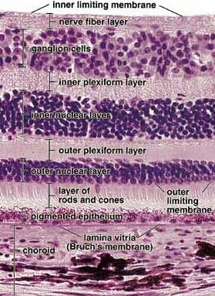
Retinal Anatomy and Histology
Neurosensory Retina Layers
  Internal limiting membrane
  Nerve fiber layer
  Ganglion cell layer
  Inner plexiform layer
  Inner nuclear layer
  Outer plexiform layer
  Outer nuclear layer
  External limiting membrane
  Rod & cone inner and outer segments
RPE
Bruch’s membrane
Review slide—no questions

Slide 63
Retinal Anatomy and Histology
Define the term macula

Slide 64
Retinal Anatomy and Histology
Now that we’re familiar with the histology of the retina, we’re ready to tackle the topography of the
We define the term macula

Slide 65
Retinal Anatomy and Histology
We define the term macula…
  …anatomically as the retinal area in which the ganglion-cell layer is ≥ 2 cells thick
  …histologically: as the retinal area containing xanthophyll pigment
  …clinically: as the retinal area bounded by the temporal vascular arcades
as well as both
and of course

Slide 66
Retinal Anatomy and Histology
We define the term macula…
  …anatomically, it is the retinal area in which the ganglion-cell layer is ≥ 2 cells thick
  …histologically it is the retinal area containing xanthophyll pigment
  …clinically it is the retinal area bounded by the temporal vascular arcades
The latest iteration of the Retina book refers to this pigment as “oxygenated carotenoids, in particular lutein and zeaxanthin”

Slide 67
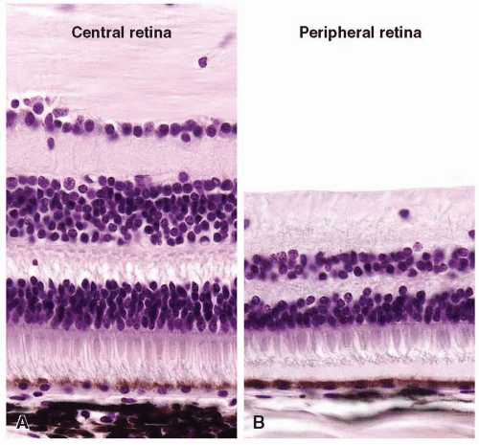
Retinal Anatomy and Histology
GCL ≥2 cells thick
GCL <2 cells thick
Changes in retinal thickness. Two sections through the central (A) and peripheral (B) regions of the retina, aligned at the retinal pigment epithelium. The peripheral retina is thinner and has only rare cell nuclei in the ganglion cell layer (the uppermost layer of nuclei).

Slide 68
Retinal Anatomy and Histology
We define the term macula…
  …anatomically, it is the retinal area in which the ganglion-cell layer is ≥ 2 cells thick
  …histologically, it is the retinal area containing xanthophyll pigment
  …clinically it is the retinal area bounded by the temporal vascular arcades

Slide 69
Retinal Anatomy and Histology
We define the term macula…
  …anatomically, it is the retinal area in which the ganglion-cell layer is ≥ 2 cells thick
  …histologically, it is the retinal area containing xanthophyll pigment
  …clinically it is the retinal area bounded by the temporal vascular arcades
Xanthophyll gives the macula a slight yellowish hue (hence the ‘full’ name of the macula being the macula lutea)

Slide 70
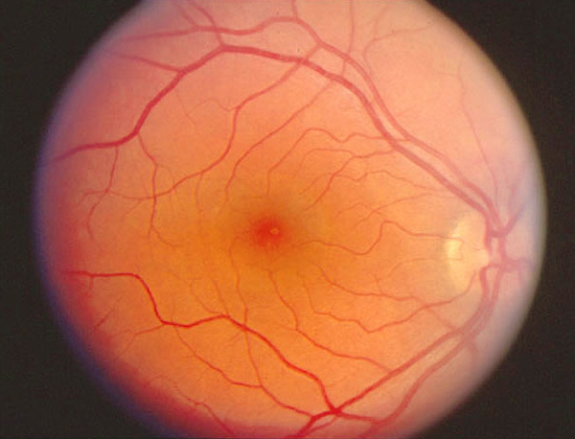

Retinal Anatomy and Histology
Macula lutea If you use your imagination, you can sort of see that the macula has a yellow tint

Slide 71
Retinal Anatomy and Histology
We define the term macula…
  …anatomically, it is the retinal area in which the ganglion-cell layer is ≥ 2 cells thick
  …histologically, it is the retinal area containing xanthophyll pigment
  …clinically, it is the retinal area bounded by the temporal vascular arcades

Slide 72
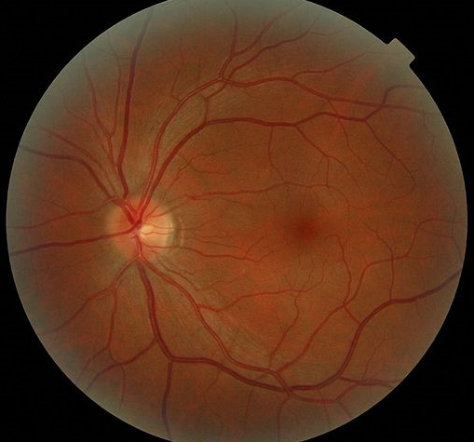
Retinal Anatomy and Histology
The clinical macula

Slide 73
Retinal Anatomy and Histology
Speaking of the clinical macula…Let’s look in some detail at its topography
The clinical macula

Slide 74
Retinal Anatomy and Histology
As said previously, the macula is defined clinically as the area bounded by the temporal arcades. It has a diameter of 5.5 to 6 mm or so.
The macula is organized around the fovea. The fovea is the central ~1.5 mm of the macula—about the size of an ONH. Its outer edge is the location at which the foveal depression starts. It contains mostly (but not exclusively) cones.
Macula

Slide 75
Retinal Anatomy and Histology
As said previously, the macula is defined clinically as the area bounded by the temporal arcades. It has a diameter of 5.5 to 6 mm or so.
The macula is organized around the fovea. The fovea is the central ~1.5 mm of the macula—about the size of an ONH. Its outer edge is the location at which the foveal depression starts. It contains mostly (but not exclusively) cones.
Macula
Fovea

Slide 76
Retinal Anatomy and Histology
As said previously, the macula is defined clinically as the area bounded by the temporal arcades. It has a diameter of 5.5 to 6 mm or so.
The macula is organized around the fovea. The fovea is the central ~1.5 mm of the macula—about the size of an ONH. Its outer edge is the location at which the foveal depression starts. It contains mostly (but not exclusively) cones.
Macula
Fovea
Foveola
The ‘floor’ of the fovea is the foveola, an area ~0.35 mm in diameter—about the size of a small optic-disc cup. The foveola contains only cones and a few glial cells; the rest of the retinal layers were left behind along the walls of the fovea. Finally, at the very center of the foveola is a small depression called the umbo. The outer segs of PRs in the umbo are especially tall.

Slide 77
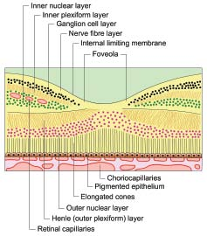
Retinal Anatomy and Histology
Foveola

Slide 78
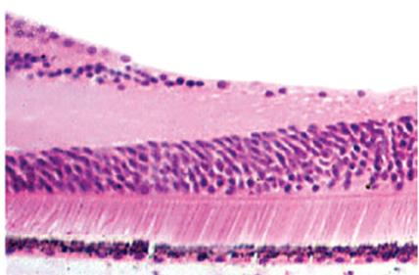
Retinal Anatomy and Histology
Foveola starts about here

Slide 79
Retinal Anatomy and Histology
As said previously, the macula is defined clinically as the area bounded by the temporal arcades. It has a diameter of 5.5 to 6 mm or so.
The macula is organized around the fovea. The fovea is the central ~1.5 mm of the macula—about the size of an ONH. Its outer edge is the location at which the foveal depression starts. It contains mostly (but not exclusively) cones.
Macula
Fovea
.
Foveola
Umbo
The ‘floor’ of the fovea is the foveola, an area ~0.35 mm in diameter—about the size of a small optic-disc cup. The foveola contains only cones and a few glial cells; the rest of the retinal layers were left behind along the walls of the fovea. Finally, at the very center of the foveola is a small depression called the umbo. The outer segs of cones within the umbo are especially tall.

Slide 80
Retinal Anatomy and Histology
As said previously, the macula is defined clinically as the area bounded by the temporal arcades. It has a diameter of 5.5 to 6 mm or so.
The macula is organized around the fovea. The fovea is the central ~1.5 mm of the macula—about the size of an ONH. Its outer edge is the location at which the foveal depression starts. It contains mostly (but not exclusively) cones.
Macula
Fovea
.
Foveola
Umbo
The ‘floor’ of the fovea is the foveola, an area ~0.35 mm in diameter—about the size of a small optic-disc cup. The foveola contains only cones and a few glial cells; the rest of the retinal layers were left behind along the walls of the fovea. Finally, at the very center of the foveola is a small depression called the umbo. The outer segs of cones within the umbo are especially tall.
Next we’ll describe the rest of the macula from the fovea outward

Slide 81
Retinal Anatomy and Histology
Macula
Fovea
.
Parafoveal zone
The parafoveal zone is the donut-shaped area about 0.5 mm in width that surrounds the fovea. (The inner edge of the donut = the outer edge of the fovea.). The parafoveal zone is where the GCL, INL and OPL are all at their thickest.
Next we’ll describe the rest of the macula from the fovea outward

Slide 82
Retinal Anatomy and Histology
The parafoveal zone is the donut-shaped area about 0.5 mm in width that surrounds the fovea. (The inner edge of the donut = the outer edge of the fovea.). The parafoveal zone is where the GCL, INL and OPL are all at their thickest.
Macula
Fovea
.
Parafoveal zone
Next we’ll describe the rest of the macula from the fovea outward

Slide 83
Retinal Anatomy and Histology
The parafoveal zone is the donut-shaped area about 0.5 mm in width that surrounds the fovea. (The inner edge of the donut = the outer edge of the fovea.). The parafoveal zone is where the GCL, INL and OPL are all at their thickest.
Macula
Fovea
.
Parafoveal zone
Next we’ll describe the rest of the macula from the fovea outward

Slide 84
Retinal Anatomy and Histology
The parafoveal zone is the donut-shaped area about 0.5 mm in width that surrounds the fovea. (The inner edge of the donut = the outer edge of the fovea.). The parafoveal zone is where the GCL, INL and OPL are all at their thickest.
Macula
Fovea
.
Perifoveal zone
Parafoveal zone
The remainder of the clinical macula—ie, the portion beyond the parafoveal zone—is the perifoveal zone. It is about 1.5 mm wide.
Next we’ll describe the rest of the macula from the fovea outward

Slide 85
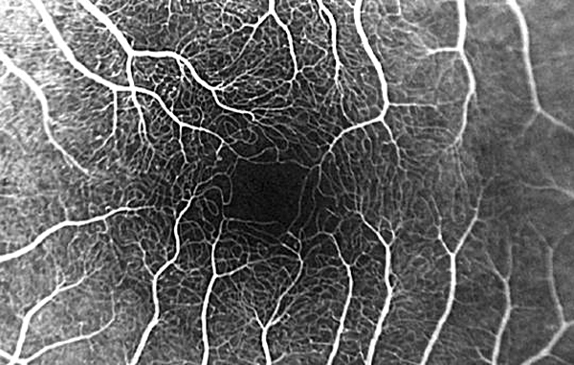
Retinal Anatomy and Histology
FAZ
In the fovea lies an area—the foveal avascular zone (FAZ)—within which no vasculature is present. The FAZ is typically about the same size as the foveola, but considerable variability exists among individuals.

Slide 86
Retinal Anatomy and Histology
Next let’s look at the retina’s
How many blood supplies

Slide 87
Retinal Anatomy and Histology
Blood supply:
?
Blood supply:
?
Blood supply:
?
Blood supply:
?
Blood supply:
?
Blood supply:
?
How many blood supplies does the retina receive?
Blood supply:
?
Blood supply:
?
Blood supply:
?
Blood supply:
?
Blood supply:
?
Blood supply:
?
Blood supply:
?

Slide 88
Retinal Anatomy and Histology
Blood supply:
?
How many blood supplies does the retina receive? Two
Blood supply:
?

Slide 89
Retinal Anatomy and Histology
Blood supply:
Central retinal artery
These are the sources of the retina’s two blood supplies
Blood supply:
Choriocapillaris

Slide 90
Retinal Anatomy and Histology
Inner 2/3 of INL on in
Retinal Layers
  Internal limiting membrane
  Nerve fiber layer
  Ganglion cell layer
  Inner plexiform layer
  Inner nuclear layer
  Outer plexiform layer
  Outer nuclear layer
  External limiting membrane
  Rod & cone inner and outer segments
RPE
Bruch’s membrane
Blood supply:
Central retinal artery
These are the layers supplied by each source
Outer 1/3 of INL on out
Blood supply:
Choriocapillaris

Slide 91
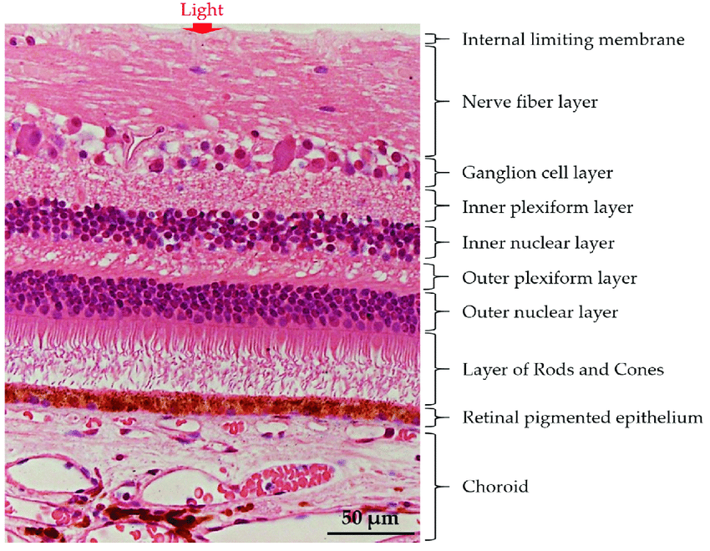
OD
Retinal Anatomy and Histology
Here is a photomicrograph of the normal human retina
(No question—proceed when ready)

Slide 92
OD
Retinal Anatomy and Histology
Here is a photomicrograph of the normal human retina
Here, approximately, is the demarcation between the layers perfused by the CRA vs the choriocapillaris
(No question—proceed when ready)

Slide 93
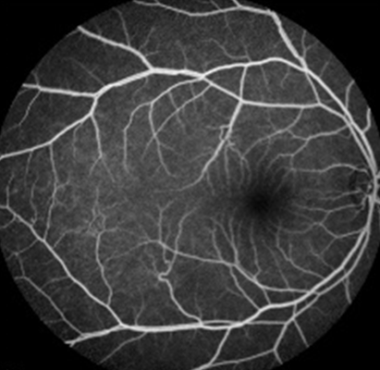
OD
Retinal Anatomy and Histology
Here is a photomicrograph of the normal human retina
Here, approximately, is the demarcation between the layers perfused by the CRA vs the choriocapillaris
Standard (ie, dye-based) FA allows visualization of the retinal and choroidal vasculatures, but the layers are all superimposed upon one another, making it impossible to distinguish among them
(No question—proceed when ready)

Slide 94
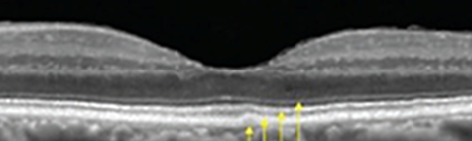
OD
Retinal Anatomy and Histology
Instead, let’s use en face OCTA to look at the ultrastructure of foveal circulation. For illustration purposes, we’re gonna pretend this is a photomicrograph of the fovea (it’s not)
Here is a photomicrograph of the normal human retina
Here, approximately, is the demarcation between the layers perfused by the CRA vs the choriocapillaris
Optical coherence tomography (OCT)
through the fovea (cross-sectional, not en face)
(No question—proceed when ready)

Slide 95
OD
Retinal Anatomy and Histology
Instead, let’s use en face OCTA to look at the ultrastructure of foveal circulation. For illustration purposes, we’re gonna pretend this is a photomicrograph of the fovea (it’s not)
The A in OCTA stand for ‘angiography.’ OCTA makes possible the visualization of the retinal vasculature without the need for intravascular dye as in FA. Further, en face OCTA not only allows us to see the vasculature, it allows us to ‘slice’ and inspect it layer by layer—something that cannot be done via conventional FA.
Here is a photomicrograph of the normal human retina
Here, approximately, is the demarcation between the layers perfused by the CRA vs the choriocapillaris
Optical coherence tomography (OCT)
through the fovea (cross-sectional, not en face)
(No question—proceed when ready)

Slide 96
OD
Retinal Anatomy and Histology
Instead, let’s use en face OCTA to look at the ultrastructure of foveal circulation. For illustration purposes, we’re gonna pretend this is a photomicrograph of the fovea (it’s not)
The A in OCTA stand for ‘angiography.’ OCTA makes possible the visualization of the retinal vasculature without the need for intravascular dye as in FA. Further, en face OCTA not only allows us to see the vasculature, it allows us to ‘slice’ and inspect it layer by layer—something that cannot be done via conventional FA.
Here is a photomicrograph of the normal human retina
Here, approximately, is the demarcation between the layers perfused by the CRA vs the choriocapillaris
Optical coherence tomography (OCT)
through the fovea (cross-sectional, not en face)
(No question—proceed when ready)

Slide 97
OD
Retinal Anatomy and Histology
Instead, let’s use en face OCTA to look at the ultrastructure of foveal circulation. For illustration purposes, we’re gonna pretend this is a photomicrograph of the fovea (it’s not).
Here is a photomicrograph of the normal human retina
Here, approximately, is the demarcation between the layers perfused by the CRA vs the choriocapillaris
Optical coherence tomography (OCT)
through the fovea (cross-sectional, not en face)
(No question—proceed when ready)

Slide 98
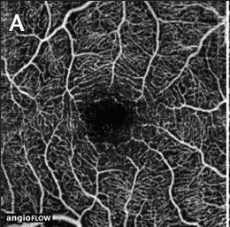
OD
Retinal Anatomy and Histology
En face OCTA
Layer of vasc visualized
Pics A, B and C depict the parafoveal vasculature as we progress deeper into the retina
(No question—proceed when ready)

Slide 99
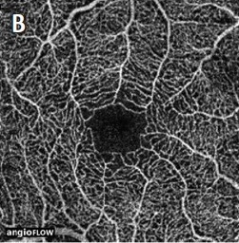
OD
Retinal Anatomy and Histology
En face OCTA
Layer of vasc visualized
Pics A, B and C depict the parafoveal vasculature as we progress deeper into the retina
(No question—proceed when ready)

Slide 100
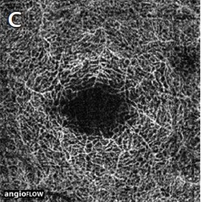
OD
Retinal Anatomy and Histology
En face OCTA
Layer of vasc visualized
Pics A, B and C depict the parafoveal vasculature as we progress deeper into the retina
(No question—proceed when ready)

Slide 101
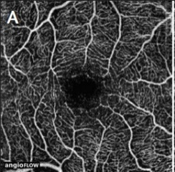
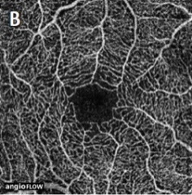
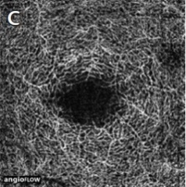
OD
Retinal Anatomy and Histology
En face OCTA
Note the foveal avascular zone (FAZ) is present in all three layers
(No question—proceed when ready)

Slide 102
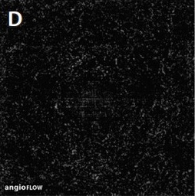
OD
Retinal Anatomy and Histology
En face OCTA
As expected, imaging of the deeper retina (D) reveals the absence of intraretinal vasculature
(No question—proceed when ready)

Slide 103
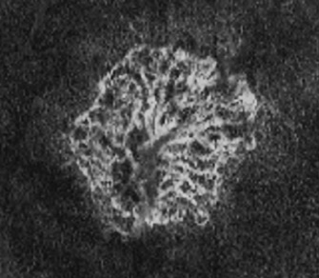
OD
Retinal Anatomy and Histology
En face OCTA
A clinical aside: Note that vessels in the deep retina, as seen here, often represent a CNVM such as is encountered in ARMD
CNVM: Choroidal neovascular membrane
ARMD: Age-related macular degeneration

Slide 104
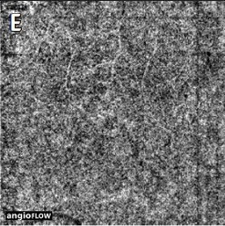
OD
Retinal Anatomy and Histology
En face OCTA
Layer of vasc visualized
Imaging of the choriocapillaris (E) indicates it contains a dense, robust vasculature.
(No question—proceed when ready)

Slide 105
OD
Retinal Anatomy and Histology
En face OCTA
Layer of vasc visualized
Imaging of the choriocapillaris (E) indicates it contains a dense, robust vasculature. As expected, note the absence of a void corresponding to the FAZ.
(No question—proceed when ready)

Slide 106
Retinal Anatomy and Histology
RPE: Functions
  1) Outer blood-ocular barrier
    Formed by zonulae occludens near cell apices
  2) Phagocytosis of rod/cone outer segments
  3) Vitamin A metabolism
    Retinol acquired, stored and transported by RPE
Next let’s look in detail at the function and structure of the RPE

Slide 107
Retinal Anatomy and Histology
RPE: Functions
  1) Outer blood-ocular barrier
    Formed by zonulae occludens near cell apices
  2) Phagocytosis of rod/cone outer segments
  3) Vitamin A metabolism
    Retinol acquired, stored and transported by RPE

Slide 108
Retinal Anatomy and Histology
RPE: Functions
  1) Outer blood-retinal barrier
  2)
  3)

Slide 109
Retinal Anatomy and Histology
RPE: Functions
  1) Outer blood-retinal barrier
    Formed by zonulae occludens near cell apices
  2)
  3)

Slide 110
Retinal Anatomy and Histology
RPE: Functions
  1) Outer blood-retinal barrier
    Formed by zonulae occludens near cell apices
  2)
  3)
As an aside, the inner blood-retinal barrier is formed by tight junctions between endothelial cells of the retinal vasculature

Slide 111
Retinal Anatomy and Histology
RPE: Functions
  1) Outer blood-retinal barrier
    Formed by zonulae occludens near cell apices
  2) Phagocytosis of rod/cone outer segments
  3)

Slide 112
Retinal Anatomy and Histology
RPE: Functions
  1) Outer blood-retinal barrier
    Formed by zonulae occludens near cell apices
  2) Phagocytosis of rod/cone outer segments
  3) Vitamin A metabolism

Slide 113
Retinal Anatomy and Histology
RPE: Functions
  1) Outer blood-retinal barrier
    Formed by zonulae occludens near cell apices
  2) Phagocytosis of rod/cone outer segments
  3) Vitamin A metabolism
    Retinol acquired, stored and transported by RPE

Slide 114
Retinal Anatomy and Histology
The five layers of Bruch’s membrane:
  Basement membrane of RPE
1)
2)
3)
4)
5)
1)
2)
3)
4)
5)
Innermost
Bruch’s membrane
Outermost

Slide 115
Retinal Anatomy and Histology
The five layers of Bruch’s membrane:
  Basement membrane of RPE
  Inner collagenous layer
1)
2)
3)
4)
5)
1)
2)
3)
4)
5)
Innermost
Bruch’s membrane
Outermost

Slide 116
Retinal Anatomy and Histology
The five layers of Bruch’s membrane:
  Basement membrane of RPE
  Inner collagenous layer
  Elastic layer
1)
2)
3)
4)
5)
1)
2)
3)
4)
5)
Innermost
Bruch’s membrane
Outermost

Slide 117
Retinal Anatomy and Histology
The five layers of Bruch’s membrane:
  Basement membrane of RPE
  Inner collagenous layer
  Elastic layer
  Outer collagenous layer
1)
2)
3)
4)
5)
1)
2)
3)
4)
5)
Innermost
Bruch’s membrane
Outermost

Slide 118
Retinal Anatomy and Histology
The five layers of Bruch’s membrane:
  Basement membrane of RPE
  Inner collagenous layer
  Elastic layer
  Outer collagenous layer
  Basement membrane of choriocapillaris
1)
2)
3)
4)
5)
1)
2)
3)
4)
5)
Innermost
Bruch’s membrane
Outermost

Slide 119
Retinal Anatomy and Histology
The five layers of Bruch’s membrane:
  Basement membrane of RPE
  Inner collagenous layer
  Elastic layer
  Outer collagenous layer
  Basement membrane of choriocapillaris
0) RPE cells
The RPE cells themselves go here
1)
2)
3)
4)
5)
Innermost
Bruch’s membrane
Outermost

Slide 120
Retinal Anatomy and Histology
The five layers of Bruch’s membrane:
  Basement membrane of RPE
  Inner collagenous layer
  Elastic layer
  Outer collagenous layer
  Basement membrane of choriocapillaris
0) RPE cells RPE cells
So, the plasma membranes of the RPE cells…
1)
2)
3)
4)
5)
Innermost
Bruch’s membrane
Outermost

Slide 121
Retinal Anatomy and Histology
The five layers of Bruch’s membrane:
  Basement membrane of RPE
  Inner collagenous layer
  Elastic layer
  Outer collagenous layer
  Basement membrane of choriocapillaris
0) RPE cells RPE cells
So, the plasma membranes of the RPE cells…
sit directly on their BM
1)
2)
3)
4)
5)
Innermost
Bruch’s membrane
Outermost

Slide 122
Retinal Anatomy and Histology
-1) PR outer segs
PR outer segs are next
The five layers of Bruch’s membrane:
  Basement membrane of RPE
  Inner collagenous layer
  Elastic layer
  Outer collagenous layer
  Basement membrane of choriocapillaris
0) RPE cells RPE cells
1)
2)
3)
4)
5)
Innermost
Bruch’s membrane
Outermost

Slide 123
Retinal Anatomy and Histology
-1) PR outer segs
The five layers of Bruch’s membrane:
  Basement membrane of RPE
  Inner collagenous layer
  Elastic layer
  Outer collagenous layer
  Basement membrane of choriocapillaris
Note that both the RPE apical membranes…
0) RPE cells RPE cells
1)
2)
3)
4)
5)
Innermost
Bruch’s membrane
Outermost

Slide 124
Retinal Anatomy and Histology
-1) PR outer segs
The five layers of Bruch’s membrane:
  Basement membrane of RPE
  Inner collagenous layer
  Elastic layer
  Outer collagenous layer
  Basement membrane of choriocapillaris
Note that both the RPE apical membranes…
0) RPE cells RPE cells
and their basal membranes…
1)
2)
3)
4)
5)
Innermost
Bruch’s membrane
Outermost

Slide 125
Retinal Anatomy and Histology
-1) PR outer segs
The five layers of Bruch’s membrane:
  Basement membrane of RPE
  Inner collagenous layer
  Elastic layer
  Outer collagenous layer
  Basement membrane of choriocapillaris
Note that both the RPE apical membranes…
0) RPE cells RPE cells
are highly infolded.
and their basal membranes…
1)
2)
3)
4)
5)
Innermost
Bruch’s membrane
Outermost

Slide 126
Retinal Anatomy and Histology
-1) PR outer segs
The five layers of Bruch’s membrane:
  Basement membrane of RPE
  Inner collagenous layer
  Elastic layer
  Outer collagenous layer
  Basement membrane of choriocapillaris
But note further that, while the PRs closely interdigitate with these infoldings…
0) RPE cells RPE cells
1)
2)
3)
4)
5)
Innermost
Bruch’s membrane
Outermost

Slide 127
Retinal Anatomy and Histology
-1) PR outer segs
The five layers of Bruch’s membrane:
  Basement membrane of RPE
  Inner collagenous layer
  Elastic layer
  Outer collagenous layer
  Basement membrane of choriocapillaris
But note further that, while the PRs closely interdigitate with these infoldings…
0) RPE cells RPE cells
the BM does not.
1)
2)
3)
4)
5)
Innermost
Bruch’s membrane
Outermost

Slide 128
Retinal Anatomy and Histology
-1) PR outer segs
The five layers of Bruch’s membrane:
  Basement membrane of RPE
  Inner collagenous layer
  Elastic layer
  Outer collagenous layer
  Basement membrane of choriocapillaris
But note further that, while the PRs closely interdigitate with these infoldings…
0) RPE cells RPE cells
Recall that a central function of the RPE is to provide metabolic support for the PRs. The interdigitations greatly increase the total surface area of PR-RPE contact, thereby facilitating these metabolic efforts.
the BM does not.
1)
2)
3)
4)
5)
Innermost
Bruch’s membrane
Outermost

Slide 129
Retinal Anatomy and Histology
-2) Bipolar cells
Bipolar cells are next
-1) PR outer segs
The five layers of Bruch’s membrane:
  Basement membrane of RPE
  Inner collagenous layer
  Elastic layer
  Outer collagenous layer
  Basement membrane of choriocapillaris
0) RPE cells RPE cells
1)
2)
3)
4)
5)
Innermost
Bruch’s membrane
Outermost

Slide 130
Retinal Anatomy and Histology
-2) Bipolar cells
-1) PR outer segs
The five layers of Bruch’s membrane:
  Basement membrane of RPE
  Inner collagenous layer
  Elastic layer
  Outer collagenous layer
  Basement membrane of choriocapillaris
0) RPE cells RPE cells
1)
2)
3)
4)
5)
1)
2)
3)
4)
5)
Innermost
Bruch’s membrane
Outermost
Down here is…
The choriocapillaris
-6) Chorio ?

Slide 131
Retinal Anatomy and Histology
-2) Bipolar cells
-1) PR outer segs
The five layers of Bruch’s membrane:
  Basement membrane of RPE
  Inner collagenous layer
  Elastic layer
  Outer collagenous layer
  Basement membrane of choriocapillaris
0) RPE cells RPE cells
1)
2)
3)
4)
5)
1)
2)
3)
4)
5)
Innermost
Bruch’s membrane
Outermost
Down here is…
The choriocapillaris
-6) Choriocapillaris

Slide 132
Retinal Anatomy and Histology
-2) Bipolar cells
-1) PR outer segs
The five layers of Bruch’s membrane:
  Basement membrane of RPE
  Inner collagenous layer
  Elastic layer
  Outer collagenous layer
  Basement membrane of choriocapillaris
0) RPE cells RPE cells
1)
2)
3)
4)
5)
1)
2)
3)
4)
5)
Innermost
Bruch’s membrane
Outermost
-6) Choriocapillaris
And the choroid
-7) Choroid

Slide 133
Retinal Anatomy and Histology
Next we will look at macular OCT, and relate it to what we’ve learned about the anatomy of the retina

Slide 134
Retinal Anatomy and Histology
Next we will look at macular OCT, and relate it to what we’ve learned about the anatomy of the retina
OCT stand for optical coherence tomography. It allows cross-sectional imaging of ocular structures, including the retina (tomography means ‘cross-sectional image’).

Slide 135
Retinal Anatomy and Histology
Next we will look at macular OCT, and relate it to what we’ve learned about the anatomy of the retina
OCT stand for optical coherence tomography. It allows cross-sectional imaging of ocular structures, including the retina (tomography means ‘cross-sectional image’).
It works via interferometry: A beam of coherent light is directed toward the retina, and reflects when it encounters boundaries between tissue layers of differing optical properties. The device gathers the reflected light and compares it to a standardized beam of light reflected from a reference mirror.

Slide 136
Retinal Anatomy and Histology
Next we will look at macular OCT, and relate it to what we’ve learned about the anatomy of the retina
OCT stand for optical coherence tomography. It allows cross-sectional imaging of ocular structures, including the retina (tomography means ‘cross-sectional image’).
It works via interferometry: A beam of coherent light is directed toward the retina, and reflects when it encounters boundaries between tissue layers of differing optical properties. The device gathers the reflected light and compares it to a standardized beam of light reflected from a reference mirror. In spectral-domain OCT (sdOCT), differences in the frequencies of the two reflected beams are used to infer the ultrastructure of the retina.

Slide 137
Retinal Anatomy and Histology
Synaptic processes
Cell body
The ELM
Recall this slide from earlier. The time/effort you spent committing it to memory is about to pay off.
The myoid zone
The ellipsoid zone
PR outer segs
Interdigitation zone
RPE/Bruch’s membrane

Slide 138
Retinal Anatomy and Histology
The ELM
Recall this slide from earlier. The time/effort you spent committing it to memory is about to pay off. As we will see, these structures are visible on sdOCT, and it’s vital you be able to recognize them.
The myoid zone
The ellipsoid zone
PR outer segs
Interdigitation zone
RPE/Bruch’s membrane

Slide 139
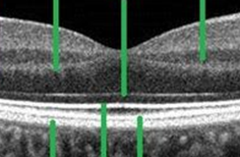
Retinal Anatomy and Histology
Let’s identify the RPE/Bruch’s complex first.
(Ignore this line)
(And this one)
Look up here
The ELM
The myoid zone
The ellipsoid zone
PR outer segs
Interdigitation zone
RPE/Bruch’s membrane

Slide 140
Retinal Anatomy and Histology
Let’s identify the RPE/Bruch’s complex first.
The RPE/Bruch’s complex is the outermost heavy white line
(Ignore this line)
(And this one)
The ELM
The myoid zone
The ellipsoid zone
PR outer segs
Interdigitation zone
Now down here
RPE/Bruch’s membrane
RPE/Bruch’s membrane
(The green line is pointing to it)

Slide 141
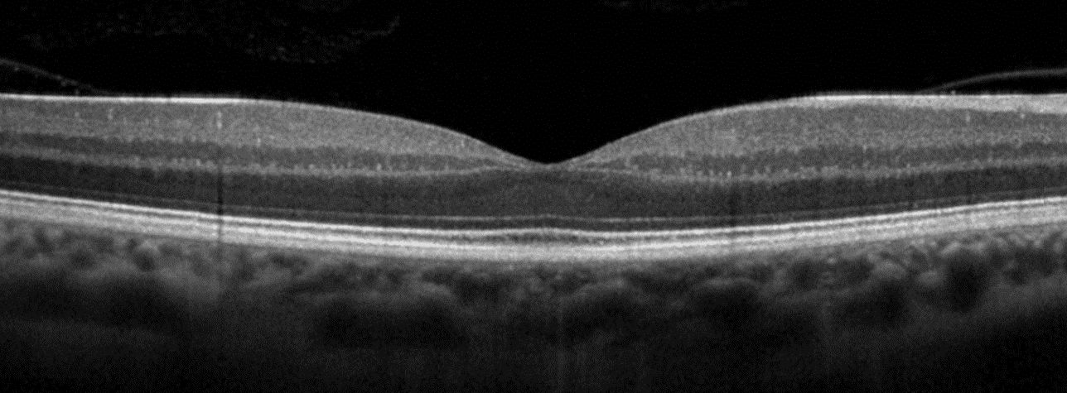
Retinal Anatomy and Histology
Let’s identify the RPE/Bruch’s complex first.
The RPE/Bruch’s complex is the outermost heavy white line
It’s hard to make out here…
(Locating the same structure on a full-size OCT image)

Slide 142
Retinal Anatomy and Histology
Let’s identify the RPE/Bruch’s complex first.
The RPE/Bruch’s complex is the outermost heavy white line
…but you can see it clearly here.
It’s hard to make out here…
(Locating the same structure on a full-size OCT image)

Slide 143
Retinal Anatomy and Histology
Let’s identify the RPE/Bruch’s complex first.
The RPE/Bruch’s complex is the outermost heavy white line
…but you can see it clearly here.
It’s hard to make out here…
You must identify and assess the integrity of the RPE/Bruch’s complex on every OCT you read!
(Locating the same structure on a full-size OCT image)

Slide 144
Retinal Anatomy and Histology
Next is the interdigitation zone.
(Ignore this line)
(And this one)
The ELM
The myoid zone
The ellipsoid zone
PR outer segs
Interdigitation zone
RPE/Bruch’s membrane
RPE/Bruch’s membrane

Slide 145
Retinal Anatomy and Histology
Next is the interdigitation zone.
It is the next heavy white line
(Ignore this line)
(And this one)
The ELM
The myoid zone
The ellipsoid zone
PR outer segs
Interdigitation zone
RPE/Bruch’s membrane
Interdigitation zone
RPE/Bruch’s membrane
(Ditto)

Slide 146
Retinal Anatomy and Histology
Next is the interdigitation zone.
It is the next heavy white line
Again, it’s hard to make out here…
(Locating the same structure on a full-size OCT image)

Slide 147
Retinal Anatomy and Histology
Next is the interdigitation zone.
It is the next heavy white line
…but it can be seen clearly over here.
Again, it’s hard to make out here…
(Locating the same structure on a full-size OCT image)

Slide 148
Retinal Anatomy and Histology
Next is the interdigitation zone.
It is the next heavy white line
…but it can be seen clearly over here.
Again, it’s hard to make out here…
The interdigitation zone is not always clearly visible on OCT
(Locating the same structure on a full-size OCT image)

Slide 149
Retinal Anatomy and Histology
Next is the PR outer segs.
(Ignore this line)
(And this one)
The ELM
The myoid zone
The ellipsoid zone
PR outer segs
Interdigitation zone
RPE/Bruch’s membrane
Interdigitation zone
RPE/Bruch’s membrane

Slide 150
Retinal Anatomy and Histology
Next is the PR outer segs.
In the dark band just inside the interdigitation zone
(Ignore this line)
(And this one)
PR outer segs (dark area)
The ELM
The myoid zone
The ellipsoid zone
PR outer segs
Interdigitation zone
RPE/Bruch’s membrane
Interdigitation zone
RPE/Bruch’s membrane

Slide 151
Retinal Anatomy and Histology
Next is the PR outer segs.
In the dark band just inside the interdigitation zone
…and harder over here.
This band is easiest to see here…
The PR outer segs band is taller at the fovea because the outer segs are longer here
(Locating the same structure on a full-size OCT image)

Slide 152
Retinal Anatomy and Histology
Next is the ellipsoid zone.
(Ignore this line)
(And this one)
PR outer segs (dark area)
The ELM
The myoid zone
The ellipsoid zone
PR outer segs
Interdigitation zone
RPE/Bruch’s membrane
Interdigitation zone
RPE/Bruch’s membrane

Slide 153
Retinal Anatomy and Histology
Next is the ellipsoid zone.
It is the heavy white band inside the outer segs
(Ignore this line)
(And this one)
PR outer segs (dark area)
The ELM
The myoid zone
The ellipsoid zone
PR outer segs
Interdigitation zone
RPE/Bruch’s membrane
Ellipsoid zone (the white line)
Interdigitation zone
RPE/Bruch’s membrane

Slide 154
Retinal Anatomy and Histology
Next is the ellipsoid zone.
It is the heavy white band inside the outer segs
The ellipsoid zone is usually readily visible across the OCT
Many PR and other outer-retinal diseases manifest as changes to the EZ. Like the RPE/Bruch’s complex, the EZ must be identified and assessed on every retinal OCT!
(Locating the same structure on a full-size OCT image)

Slide 155
Retinal Anatomy and Histology
Next is the myoid zone.
(Ignore this line)
(And this one)
PR outer segs (dark area)
The ELM
The myoid zone
The ellipsoid zone
PR outer segs
Interdigitation zone
RPE/Bruch’s membrane
Ellipsoid zone (the white line)
Interdigitation zone
RPE/Bruch’s membrane

Slide 156
Retinal Anatomy and Histology
Next is the myoid zone.
The dark band just inside the ellipsoid zone
(Ignore this line)
(And this one)
PR outer segs (dark area)
Myoid zone (dark area)
The ELM
The myoid zone
The ellipsoid zone
PR outer segs
Interdigitation zone
RPE/Bruch’s membrane
Ellipsoid zone (the white line)
Interdigitation zone
RPE/Bruch’s membrane

Slide 157
Retinal Anatomy and Histology
Next is the myoid zone.
The dark band just inside the ellipsoid zone
The myoid zone is best visualized at the fovea
(Locating the same structure on a full-size OCT image)

Slide 158
Retinal Anatomy and Histology
Next is the ELM.
(Ignore this line)
(And this one)
PR outer segs (dark area)
Myoid zone (dark area)
The ELM
The myoid zone
The ellipsoid zone
PR outer segs
Interdigitation zone
RPE/Bruch’s membrane
Ellipsoid zone (the white line)
Interdigitation zone
RPE/Bruch’s membrane

Slide 159
Retinal Anatomy and Histology
Next is the ELM.
It’s the thin white band just inside the myoid zone
(the white line) ELM
(Ignore this line)
(And this one)
PR outer segs (dark area)
Myoid zone (dark area)
The ELM
The myoid zone
The ellipsoid zone
PR outer segs
Interdigitation zone
RPE/Bruch’s membrane
Ellipsoid zone (the white line)
Interdigitation zone
RPE/Bruch’s membrane

Slide 160
Retinal Anatomy and Histology
Next is the ELM.
It’s the thin white band just inside the myoid zone
The ELM also is easiest to see at the fovea
(Locating the same structure on a full-size OCT image)

Slide 161
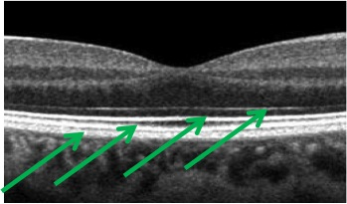
Retinal Anatomy and Histology
?
?
?
?
?
?
Quiz yourself by toggling back and forth between this slide and the next

Slide 162
Retinal Anatomy and Histology
PR outer segs (dark area)
Myoid zone (dark area)
ELM
EZ
Interdigitation zone
RPE/Bruch’s complex
(the white line)
Quiz yourself by toggling back and forth between this slide and the next

Slide 163
Retinal Anatomy and Histology
PR outer segs (dark area)
Myoid zone (dark area)
ELM
EZ
Interdigitation zone
RPE/Bruch’s complex
(the white line)
An important meta-point to come away with from all this is, OCT bands are determined by differences in tissue reflectivity, but differences in reflectivity don’t necessarily correlate 1:1 with retinal anatomy.

Slide 164
Retinal Anatomy and Histology
PR outer segs (dark area)
Myoid zone (dark area)
ELM
EZ
Interdigitation zone
RPE/Bruch’s complex
(the white line)
An important meta-point to come away with from all this is, OCT bands are determined by differences in tissue reflectivity, but differences in reflectivity don’t necessarily correlate 1:1 with retinal anatomy. Consider the ellipsoid and myoid of the PRs. They are parts of the same anatomic structure (the PR inner seg), but to the OCT scanner, they look radically different from one another.

Slide 165
Retinal Anatomy and Histology
PR outer segs (dark area)
Myoid zone (dark area)
ELM
EZ
Interdigitation zone
RPE/Bruch’s complex
(the white line)
An important meta-point to come away with from all this is, OCT bands are determined by differences in tissue reflectivity, but differences in reflectivity don’t necessarily correlate 1:1 with retinal anatomy. Consider the ellipsoid and myoid of the PRs. They are parts of the same anatomic structure (the PR inner seg), but to the OCT scanner, they look radically different from one another. Remember, the OCT is under no obligation to ‘see’ the retina the way an anatomist sees it.

Slide 166
Retinal Anatomy and Histology
For the remainder of our intro to OCT, we’re going to switch gears and work outward from the inner aspect of the scan
(No question—proceed when ready)

Slide 167
Retinal Anatomy and Histology
First things first: In order to ‘set the floor’ re how far down we need to go, locate the ELM:

Slide 168
Retinal Anatomy and Histology
ELM
First things first: In order to ‘set the floor’ re how far down we need to go, locate the ELM:

Slide 169
Retinal Anatomy and Histology
Formed vitreous
ELM
Next, let’s identify the following preretinal structures:
--The formed vitreous

Slide 170
Retinal Anatomy and Histology
Posterior cortical vitreous
Formed vitreous
Posterior cortical vitreous
ELM
Next, let’s identify the following preretinal structures:
--The formed vitreous
--The posterior cortical vitreous

Slide 171
Retinal Anatomy and Histology
Posterior cortical vitreous
Formed vitreous
Posterior cortical vitreous
Preretinal space
Preretinal space
ELM
Next, let’s identify the following preretinal structures:
--The formed vitreous
--The posterior cortical vitreous
--The preretinal space

Slide 172
Retinal Anatomy and Histology
Posterior cortical vitreous
Formed vitreous
Posterior cortical vitreous
Preretinal space
ILM
Preretinal space
ELM
Next, let’s identify the following preretinal structures:
--The formed vitreous
--The posterior cortical vitreous
--The preretinal space
And now the innermost retinal structure, the ILM:

Slide 173
Retinal Anatomy and Histology
Posterior cortical vitreous
Formed vitreous
Posterior cortical vitreous
Preretinal space
ILM
Preretinal space
NFL
ELM
Next commences the layers of neural elements, starting with the nerve fiber layer

Slide 174
Retinal Anatomy and Histology
Posterior cortical vitreous
Formed vitreous
Posterior cortical vitreous
Preretinal space
ILM
Preretinal space
NFL
ELM
On this scan, this side is temporal, and this side is nasal.
You can tell because the NFL is always thicker on the nasal side, owing to the fact that this is the side the papillomacular bundle is located on.
Next commences the layers of neural elements, starting with the nerve fiber layer
Temporal
Nasal

Slide 175
Retinal Anatomy and Histology
Posterior cortical vitreous
Formed vitreous
Posterior cortical vitreous
Preretinal space
ILM
Preretinal space
NFL
ELM
On this scan, this side is temporal, and this side is nasal.
You can tell because the NFL is always thicker on the nasal side, owing to the fact that this is the side the papillomacular bundle is located on.
Next commences the layers of neural elements, starting with the nerve fiber layer
Temporal
Nasal

Slide 176
Retinal Anatomy and Histology
Posterior cortical vitreous
Formed vitreous
Posterior cortical vitreous
Preretinal space
ILM
Preretinal space
NFL
ELM
On this scan, this side is temporal, and this side is nasal.
You can tell because the NFL is always thicker on the nasal side, owing to the fact that this is the side the papillomacular bundle is located on.
Next commences the layers of neural elements, starting with the nerve fiber layer
Temporal
Nasal
The PMB is the set of fibers running from the fovea directly to the ONH

Slide 177
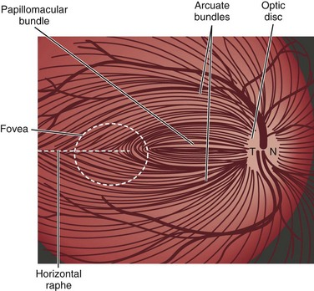
Retinal Anatomy and Histology
Papillomacular bundle

Slide 178
Retinal Anatomy and Histology
Posterior cortical vitreous
Formed vitreous
Posterior cortical vitreous
Preretinal space
ILM
Preretinal space
Ganglion cell layer
NFL
ELM
Next commences the layers of neural elements, starting with the nerve fiber layer . As the composition of the layers alternate, the next one must contain cell bodies; sure enough, it is the ganglion cell layer .

Slide 179
Retinal Anatomy and Histology
Posterior cortical vitreous
Formed vitreous
Posterior cortical vitreous
Preretinal space
ILM
Preretinal space
Ganglion cell layer
NFL
Inner plexiform layer
ELM
Next commences the layers of neural elements, starting with the nerve fiber layer . As the composition of the layers alternate, the next one must contain cell bodies; sure enough, it is the ganglion cell layer . The next, ‘processes’ layer is the inner plexiform layer

Slide 180
Retinal Anatomy and Histology
Posterior cortical vitreous
Formed vitreous
Posterior cortical vitreous
Preretinal space
ILM
Preretinal space
Ganglion cell layer
NFL
Inner plexiform layer
Inner nuclear layer
ELM
Next commences the layers of neural elements, starting with the nerve fiber layer . As the composition of the layers alternate, the next one must contain cell bodies; sure enough, it is the ganglion cell layer . The next, ‘processes’ layer is the inner plexiform layer , followed by the next cell-body layer, the inner nuclear layer .

Slide 181
Retinal Anatomy and Histology
ELM
Things seem to be working out perfectly. The OCT appears to have two layers left to identify.

Slide 182
Retinal Anatomy and Histology
Outer plexiform layer
ELM
Things seem to be working out perfectly. The OCT appears to have two layers left to identify. Conveniently, there are two yet-unassigned layers—a processes layer (the outer plexiform layer )

Slide 183
Retinal Anatomy and Histology
Outer plexiform layer
Outer nuclear layer
ELM
Things seem to be working out perfectly. The OCT appears to have two layers left to identify. Conveniently, there are two yet-unassigned layers—a processes layer (the outer plexiform layer ), and a cell-bodies layer (the outer nuclear layer ).

Slide 184
Retinal Anatomy and Histology
Outer plexiform layer
Outer nuclear layer
ELM
Things seem to be working out perfectly. The OCT appears to have two layers left to identify. Conveniently, there are two yet-unassigned layers—a processes layer (the outer plexiform layer ), and a cell-bodies layer (the outer nuclear layer ). Not uncommonly, you will see OCTs labeled in just this fashion.

Slide 185
Retinal Anatomy and Histology
Outer plexiform layer
But this is incorrect!
Outer nuclear layer
ELM
Things seem to be working out perfectly. The OCT appears to have two layers left to identify. Conveniently, there are two yet-unassigned layers—a processes layer (the outer plexiform layer ), and a cell-bodies layer (the outer nuclear layer ). Not uncommonly, you will see OCTs labeled in just this fashion.
But this is incorrect!

Slide 186
Retinal Anatomy and Histology
But this is incorrect!
ELM
has three
Things seem to be working out perfectly. The OCT appears to have two layers left to identify. Conveniently, there are two yet-unassigned layers—a processes layer (the outer plexiform layer ), and a cell-bodies layer (the outer nuclear layer ). Not uncommonly, you will see OCTs labeled in just this fashion.
Why is it incorrect? Because the OCT has three layers left—not two!

Slide 187
Retinal Anatomy and Histology
ELM
Look carefully at the remaining darker portion, and you will note the presence of a subtle demarcation line within it. (I will point it out on the next slide.)

Slide 188
Retinal Anatomy and Histology
ELM
Look carefully at the remaining darker portion, and you will note the presence of a subtle demarcation line within it. (I will point it out on the next slide.)

Slide 189
Retinal Anatomy and Histology
Demarcation between…Henle’s layer and the ONL
Henle’s layer
Outer nuclear layer
ELM
Look carefully at the remaining darker portion, and you will note the presence of a subtle demarcation line within it. (I will point it out on the next slide.) This line demarcates between the outer nuclear layer and Henle’s layer .

Slide 190
Retinal Anatomy and Histology
Demarcation between…Henle’s layer and the ONL
Henle’s layer
Outer nuclear layer
ELM
We mentioned Henle’s layer earlier in the context of the OPL , when we noted that the terms were often (and erroneously) treated as synonyms. Here’s why they’re not synonymous. Recall that the OPL consists of the axonal processes of the PRs and the dendritic processes of the bipolar cells. (There’s some horizontal-cell processes in there as well.)
Look carefully at the remaining darker portion, and you will note the presence of a subtle demarcation line within it. (I will point it out on the next slide.) This line demarcates between the outer nuclear layer and Henle’s layer .

Slide 191
Retinal Anatomy and Histology
Demarcation between…Henle’s layer and the ONL
Henle’s layer
Outer nuclear layer
ELM
We mentioned Henle’s layer earlier in the context of the OPL , when we noted that the terms were often (and erroneously) treated as synonyms. Here’s why they’re not synonymous. Recall that the OPL consists of the axonal processes of the PRs and the dendritic processes of the bipolar cells. (There’s some horizontal-cell processes in there as well.)
Look carefully at the remaining darker portion, and you will note the presence of a subtle demarcation line within it. (I will point it out on the next slide.) This line demarcates between the outer nuclear layer and Henle’s layer .

Slide 192
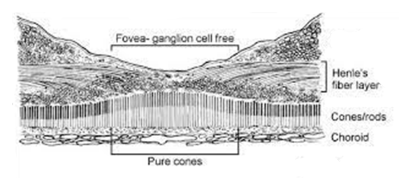
Retinal Anatomy and Histology
However, in the fovea/parafoveal region, the axonal processes of the PRs are elongated, and radiate directly away from the foveal center in all directions, running almost parallel to the retinal surface (see above). These long, radially oriented axonal fibers comprise the Henle’s layer portion of the OPL.

Slide 193
Retinal Anatomy and Histology
Demarcation between…Henle’s layer and the ONL
Outer nuclear layer
ELM
You can now appreciate the appearance of the OCT in the foveal region. The orientation of the PR axons leads the OCT to ‘see’ them as a layer separate and distinct from that of the bipolar-cell dendrites with which they form the outer plexus.

Slide 194
Retinal Anatomy and Histology
Demarcation between…Henle’s layer and the ONL
Dendritic portion of the OPL
Axonal portion of the OPL
(aka Henle’s layer)
Outer nuclear layer
ELM
You can now appreciate the appearance of the OCT in the foveal region. The orientation of the PR axons leads the OCT to ‘see’ them as a layer separate and distinct from that of the bipolar-cell dendrites with which they form the outer plexus. This is why it’s misleading to treat the terms Henle’s layer and OPL as synonyms: Technically speaking, Henle’s layer is the axonal portion of the OPL in the foveal and parafoveal region.

Slide 195
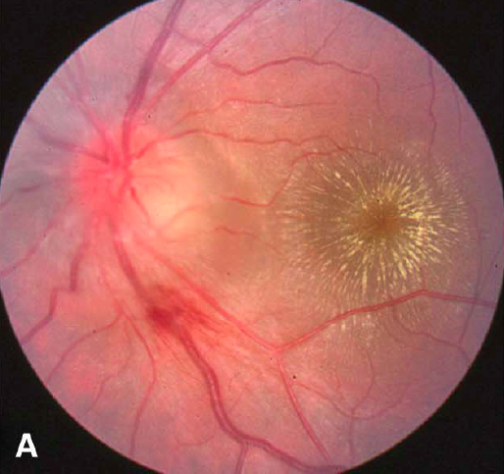
Retinal Anatomy and Histology
Highly relevant sidebar: The condition depicted above is neuroretinitis. (The neuro- part refers to the ONH swelling.) The classic cause is infection with Bartonella henslae; it is a form of cat-scratch disease. The descriptive term for the appearance of the macula in neuroretinitis is a macular star.

Slide 196
Retinal Anatomy and Histology
Highly relevant sidebar: The condition depicted above is neuroretinitis. (The neuro- part refers to the ONH swelling.) The classic cause is infection with Bartonella henslae; it is a form of cat-scratch disease. The descriptive term for the appearance of the macula in neuroretinitis is a macular star.
The point of this sidebar: The reason a macular star look the way it does is that the exudate is located in Henle’s layer, and thus it mirrors Henle’s radial orientation.

Slide 197
Retinal Anatomy and Histology
Make a connection in your head between the clinical appearance of a macular star…

Slide 198
Retinal Anatomy and Histology
Dendritic portion of the OPL
Axonal portion of the OPL
ELM
Make a connection in your head between the clinical appearance of a macular star… and the OCT appearance of Henle’s layer.

Slide 199
Retinal Anatomy and Histology
Dendritic portion of the OPL
Axonal portion of the OPL
ELM
Make a connection in your head between the clinical appearance of a macular star… and the OCT appearance of Henle’s layer. While they look nothing like one another, each arises from the same fundamental fact of retinal anatomy/histology!

Slide 200
Retinal Anatomy and Histology
One last word about this OPL/Henle’s layer issue—you will find that the BCSC books are not consistent in how they use these terms. (For example, the Retina book uses them as synonyms on one page, and as referring to separate layers two pages later.)

Slide 201
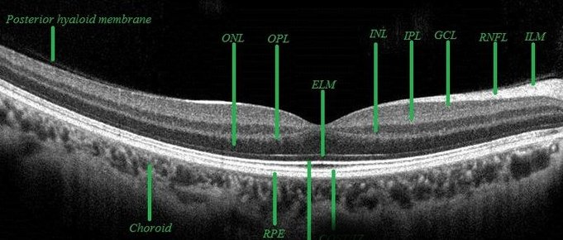
Retinal Anatomy and Histology
One last word about this OPL/Henle’s layer issue—you will find that the BCSC books are not consistent in how they use these terms. (For example, the Retina book uses them as synonyms on one page, and as referring to separate layers two pages later.) Likewise, you will frequently encounter OCT images labeled in a manner that is unclear or misleading regarding what is the OPL, what is Henle’s, and what is the ONL (eg, the above). You may also find that your program’s retina specialist disagrees with how I’ve laid things out here. Caveat emptor.

Slide 202
Retinal Anatomy and Histology
?
?
?
?
?
?
?
?
?
?
?
?
aka ?
??????
?
Quiz yourself by toggling back and forth between this slide and the next. When you’ve got it, you’re done!

Slide 203
Retinal Anatomy and Histology
Posterior cortical vitreous
Formed vitreous
Posterior cortical vitreous
Preretinal space
ILM
Preretinal space
Ganglion cell layer
NFL
Inner plexiform layer
Inner nuclear layer
Dendritic portion of the OPL
Axonal portion of the OPL
aka Henle’s layer
Outer nuclear layer
ELM

Slide 204
Retinal Anatomy and Histology
That’s it! Go through this slide-set a couple of times (at least) until you feel like you have a handle on it. When you’re ready, do slide-set R17, which covers this material in a Q&A format (and more detail).

