Slide 1
AAO Code of Ethics Rule of the Month
Rule 3. Research and Innovation

Slide 2
Ethical Research and Innovation Why is This Topic Important?
Patient Protection
Respect for Human Dignity
Acting in the Best Interests of the Patient
Integrity of the Profession
Notes:
Obligation to be Truthful
Engenders Patient Trust
Develops Patient Autonomy
Integrity of the Profession

Slide 3
The Purpose of Ophthalmic Research
Ophthalmic researchers have the potential to “profoundly change medicine for the better”, as noted by Dr. Ruth Williams in her April 2017 EyeNet editorial.
Of primary concern is the welfare of patients and accurately portraying any research study in communications to the public, especially to a vulnerable patient population.

Slide 4
Code of Ethics - Rule 3
Research and Innovation.
Research is conducted to provide information on which to base diagnostic, prognostic or therapeutic decisions and/or to improve understanding of pathogenesis in circumstances in which insufficient information exists. Research and innovation must be approved by appropriate review mechanisms (Institutional Review Board; IRB) and must comply with all requirements of the approved study protocol to protect patients from being subjected to or potentially affected by inappropriate or fraudulent research. In emerging areas of ophthalmic treatment where recognized guidelines do not exist, the ophthalmologist should exercise careful judgment and take appropriate precautions to safeguard patient welfare. Appropriate informed consent for research and innovative procedures must recognize their special nature and ramifications. The ophthalmologist must demonstrate an understanding of the purpose and goals of the research and recognize and disclose financial and non-financial conflicts of interest. Commensurate with the level of his/her involvement, the investigator must accept personal accountability for patient safety and compliance with all legal and IRB-imposed requirements.
Notes:
Four elements of Informed consent:
Beneficence – do what’s right
Non-maleficence – don’t do what’s wrong
Justice – include all relevant info – different for each patient
Autonomy (self governance) (some say truth-telling) – help the patient make informed decisions

Slide 5
The Purpose of Rule 3 of the Code of Ethics
To protect patients from being subjected to or potentially affected by inappropriate, or fraudulent research, and/or innovation in clinical practice.
This rule advances Principle 2 of the Code of Ethics that "ophthalmological services must be provided with ... respect for human dignity ..." and Principle 7 that an ophthalmologist must "act in the best interest of the patient."
Rule 3 defines research and innovation in clinical practice as activities that are undertaken in circumstances where "insufficient information exists," and therefore procedures are “conducted to provide information on which to base diagnostic, prognostic or therapeutic decisions and/or to improve understanding of pathogenesis ...."

Slide 6
Cornerstone Documents About Human Research
Nuremburg Code 1949 – Post-Nazi era in response to evidence of human experimentation
Human research needs to be necessary, important and well-designed taking into account risks that are commensurate with any benefits.
It should avoid unnecessary suffering or injury and should be terminated for risk of imminent harm or death.
There must be voluntary consent of research subjects with permission to “opt out” at any time.
Declaration of Helsinki 1964 - Voluntary cooperation with special research informed consent
This declaration ensures primacy of patients’ interests as well as clear research protocols for research combined with medical care.
Belmont Report 1979 - Practice vs. research, patient benefit
Defined elements of informed consent and boundaries between practice and research

Slide 7
Historical Facts About Research and Innovation
James Lind, a Royal Navy surgeon's mate, performed one of the first controlled clinical trials recorded in medical science:
In 1747, on board HMS Salisbury, he took 12 men suffering from scurvy, divided them into six pairs, and treated them with various familiar remedies.
At the end of 6 days, the two sailors whose “remedy” was ingesting citrus fruits were well enough to nurse the others.
His report did not appear in print until 1753, and it took 42 more years for the Admiralty to require fresh lemons/lemon juice to sailors. https://www.bbc.com/news/uk-england-37320399
Notes:
1. A 1914 U.S. Supreme Court case, Schoendorff v. Society of New York Hospital, "first established that the patient was an active participant in the treatment decision process“.
Mrs. Schoendorff agreed to an "ether examination" to identify a lump causing a “disorder of the stomach”. While the patient was under anesthesia, the surgeon removed a revealed fibroid tumor… an infection, gangrene and the amputation of several fingers allegedly resulted from the operation.
Court decision,
“In the case at hand, the wrong complained of is not merely negligence. It is trespass. Every human being of adult years and sound mind has a right to determine what shall be done with his own body; and a surgeon who performs an operation without his patient's consent commits an assault, for which he is liable in damages.” ¹

Slide 8
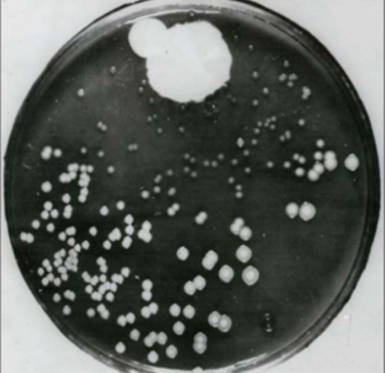
First Double Masked Clinical Trial
In 1943 England, the Medical Research Council was tasked with investigating whether patulin (a product extracted from Penicillium patulinum), was beneficial in the common cold.
Both doctor and patient were masked to the content of each treatment mode, codes letters were used for treatment bottles, and nurses dispensed treatments in strict rotation in separate rooms.
This was arguably the first double masked curative trial with concurrent controls in the general population in modern times. https://www.ncbi.nlm.nih.gov/pmc/articles/PMC1116443/

Slide 9
First Randomized Clinical Trial
In 1946 England, the Medical Research Council Tuberculosis Unit undertook a trial with penicillin to research anecdotal reports of a cure for TB and a new theory called “randomized allocation”.
Trial was to determine whether streptomycin was effective against pulmonary tuberculosis
Introduced novel allocation by random sampling numbers
Randomization replaced alternation in order to better conceal the allocation schedule
Success gave rise to virtual universal use of randomized allocation in clinical trials https://www.ncbi.nlm.nih.gov/pmc/articles/PMC1116443/

Slide 10
Research Today– Office for Human Research Protections
The Office for Human Research Protections (OHRP) was created in June 2000 to lead the Department of Health and Human Services’ efforts to protect human subjects in biomedical and behavioral research and to provide leadership for all federal agencies that conduct or support human subjects research under the Federal Policy for the Protection of Human Subjects, also known as the Common Rule.
https://www.hhs.gov/ohrp/

Slide 11
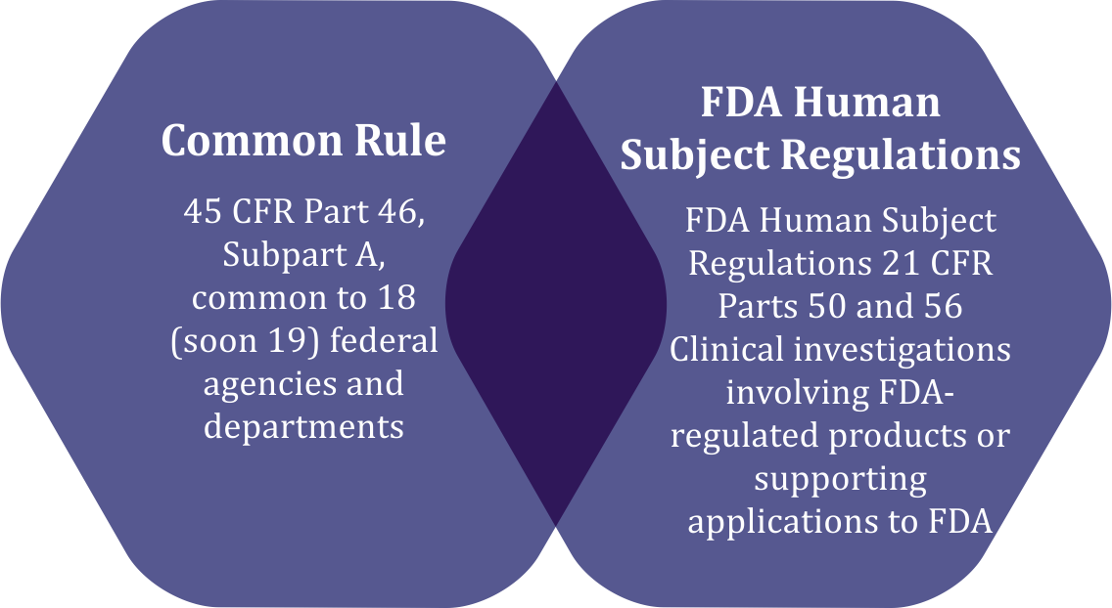
Federal Policy for the Protection of Human Subjects -The Common Rule
The Common Rule (pub 1991) outlines basic provisions for IRBs, informed consent, and compliance with federal policy for human subject research conducted or supported by a federal department/agency
The HHS regulations, 45 CFR part 46, include four subparts:
Subpart A, also known as the Federal Policy or the “Common Rule”;
Subpart B, additional protections for pregnant women, human fetuses, and neonates
Subpart C, additional protections for prisoners
Subpart D, additional protections for children
Common Rule updated July 2018
https://www.hhs.gov/ohrp/regulations-and-policy/regulations/common-rule/index.html

Slide 12
Distinguishing Between Practice of Medicine and Research
Practice of Medicine
Interventions designed solely to enhance the well-being of an individual patient or client
Intervention has a reasonable expectation of success
Purpose is to provide diagnosis, preventive treatment, or therapy to a particular individual
Research
Activity designed to test a hypothesis, permit conclusions to be drawn, develop or contribute to generalizable knowledge
Usually described in a formal protocol that sets forth an objective and a set of procedures designed to reach that objective
https://www.omic.com/wp-content/uploads/2020/10/Research-or-Practice-of-Medicine-1.pdf

Slide 13
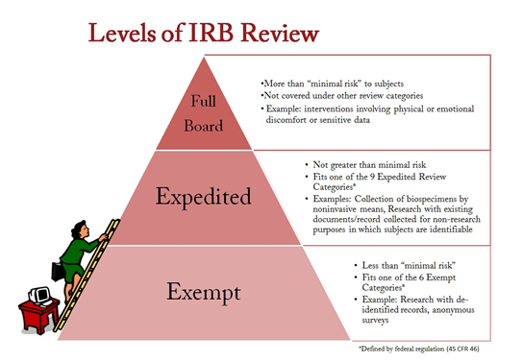
To IRB or Not to IRB?
Obtain IRB approval before you begin if you intend to:
Present at a scientific meeting
Publish in a scientific journal
Contribute to generalizable knowledge

Slide 14
Engagement in Clinical Research
Exciting potential for improvement of patient care
Study design to yield valid results
Important responsibility to protect patients
Approval by appropriate review mechanisms (IRB)
Recognize potential vulnerability of patients with conditions lacking current therapies

Slide 15
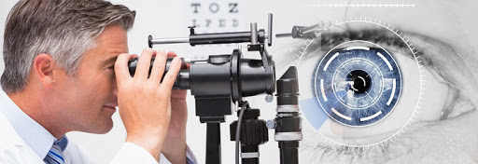
Why Ophthalmic Research?
Imagine ophthalmic care without these advances based on research:
Pharmaceuticals- glaucoma, AMD- anti-VEGF treatments
Laser therapy- Diabetic retinopathy, glaucoma
Corneal transplantation- DSEK, DMEK
Uveitis- PCR diagnostics, biologics
Cataract surgery and IOLs

Slide 16
The Purpose of the AAO’s Code of Ethics
The over-riding principle of the AAO’s Code of Ethics is to help the physician make clinical decisions that are in the best interest of the patient.
Rule 3 helps to ensure that the physician researcher maintains respect for human dignity, acts in the best interest of the patient and fully informs the research subjects of the reason(s) for the research, all relevant risks involved and any benefits that the patient might receive in clear and honest language.

Slide 17
Thank you -
General Inquiries & Submissions ethics@aao.org
The Redmond Ethics Center https://www.aao.org/clinical-education/redmond-ethics-center

