Slide 1
Delegation of Services and Co-management
The Co-management Dilemma

Slide 2
Why is this Topic Important?
Obligation to be Truthful
Integrity of the Profession
State and Federal Regulations

Slide 3
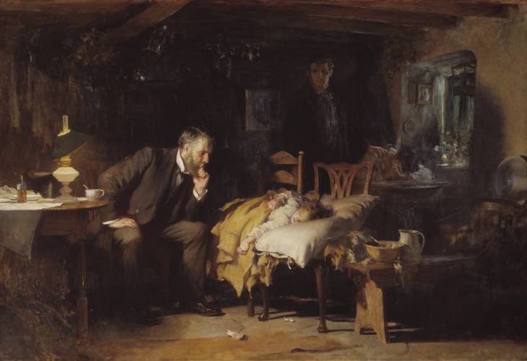
An Ophthalmologist’s Fiduciary Responsibility
Professional decision making must serve the patient’s best interests
An issue of medical ethics is generally resolved by the determination that the best interests of patients are served
Coordination of eye care between varied providers must serve the best interests of each patient
”The Doctor”, Sir Luke Filde, 1891
Notes:
Sir Luke Fildes's 1891 painting 'The Doctor.'

Slide 4
Delegation and Co-management
Ophthalmologists routinely delegate care and co-manage patients:
With the retina specialist in the practice who refers a suspected retinal detachment
With the technician who does a pressure check after glaucoma surgery
With a retired ophthalmologist who no longer performs surgery, but whose patients want to stay with her

Slide 5
Potential Problem Areas
Delegation of care and co-management raise concerns when:
There is inadequate consent
The patient is not aware of the arrangements and has not given consent
The “delegatee” is not trained or licensed to provide the delegated care
There is problematic utilization
When co-management becomes routine
No valid reason for co-managing the patient
When the primary purpose is economic
When offered as an inducement for referrals
When established by coercion or as a condition for future referrals

Slide 6
Circumstances in Which Co-Management May Be Appropriate
In integrated healthcare systems
Patient inability to return
Operating ophthalmologist’s unavailability
Patient prerogative
Change in postoperative course

Slide 7
Financial considerations
Co-management fees should be commensurate with service(s) actually provided, and separately billed by the non-operating practitioner
Medicare/Medicaid patients: co-management arrangement should be consistent with all Medicare/Medicaid billing/coding rules
The patient should be informed of, and consent in writing to, any financial compensation/additional fees charged as a result of the arrangement.
For non-covered Medicare/Medicaid services, fee structures should also be commensurate with the services provided.

Slide 8
A Note on Law and Ethics
Delegation of medical care and co-management of individual patients are not per se unethical.
Many states have regulations that address fee splitting and/or co-management, and they vary state to state.
State laws may concern procedures paid by private insurance as well as state insurance plans.
The operative word is appropriate delegation, i.e., when it is in the patient’s best interests.

Slide 9
Medicare/Medicaid Anti-Kickback Statute
Prohibits knowingly and willfully soliciting, receiving, offering or paying any “remuneration” in return for:
Referring a person for an item or service which may be paid by a “Federal Health Care Program” (e.g., Medicare/Medicaid, Veterans Health Programs, Indian Health Programs, Tricare); or
Purchasing, leasing, ordering any item or service which may be paid by a Federal Health Care Program.

Slide 10
What is “remuneration”?
“Remuneration” means giving any thing of value directly or indirectly, overtly or covertly, in cash or in kind.
Thus, the referral of cataract patients in exchange for providing post-operative care can violate the federal Anti-Kickback Statute.
The OIG has expressed concern about co-management based on economic concerns rather than clinical appropriateness and has refused to provide safe harbor protections for such arrangements.

Slide 11
Patients’ interests must never be compromised
The operating ophthalmologist should consult with qualified legal counsel and other consultants to ensure that his/her co-management practices are consistent with federal and state law and best legal practices.
Notes:
The operating ophthalmologist should consult with qualified legal counsel and other consultants to ensure that his/her co-management practices are consistent with federal and state law and best legal practices.

Slide 12
AAO Resources
Be smart, utilize AAO and other resources to educate yourself before entering into any co-management arrangement.
Comprehensive Guidelines for the Co-Management of Ophthalmic Postoperative Care
https://www.aao.org/education/ethics-detail/guidelines-comanagement-postoperative-care
5 Co-Management Coding Tips
https://www.aao.org/practice-management/news-detail/5-co-management-coding-tips

Slide 13
Co-management Code of Ethics: Applicable Rules
Rule 2: Informed Consent
Rule 6: Preoperative Assessment
Rule 7: Delegation of Services
Rule 8: Postoperative Care
Rule 11: Commercial Relationships
Rule 15: Conflict of Interest

Slide 14
Rule 2: Informed Consent
Informed Consent. The performance of medical or surgical procedures shall be preceded by appropriate informed consent.
Informed consent is a dialogue:
Assess patient’s competence to decide
Disclose relevant information a reasonable person would want to know
Assess patient’s comprehension of information
Affirmatively obtain consent from patient or surrogate
Informed consent occurs before a patient or surrogate signs anything
Informed consent is not a signature on a document.

Slide 15
Rule 6: Pretreatment Assessment
Preoperative Assessment. …The ophthalmologist must evaluate the patient and assure that the evaluation accurately documents the ophthalmic findings and the indications for treatment…
Surgeons should make surgical decisions
Potential problems caused by delegation:
Compromised physician-patient relationship
Higher risk for litigation with a surprise outcome

Slide 16
Rules 7 and 8: Delegation of Services and Postoperative Care
Aspects of care within the unique competence of the ophthalmologist must not be delegated. (Rule 7)
The providing of postoperative eye care until the patient has recovered is integral to patient management. (Rule 8)
Some aspects of care may be delegated
The delegatee must have adequate qualifications
The delegatee must be adequately supervised
The patient and the delegatee must consent in advance to the co-management arrangement

Slide 17
Rules 11 and 15: Commercial Relationships and Conflicts of Interest
An ophthalmologist’s clinical judgment and practice must not be affected by economic interest in, commitment to, or benefit from commercial enterprises. (Rule 11)
A conflict of interest exists when professional judgment…has a reasonable chance of being influenced by other interests of the provider. (Rule 15)

Slide 18
Rules 11 and 15: Commercial Relationships and Conflicts of Interest
Fees should be commensurate with services
Kickbacks and unethical and illegal
The primary rationale should not be economic
No routine arrangements
Must be patient-care rationale
No inducement for referrals
No condition for referrals

Slide 19
Rules of the Code of Ethics
Rule 1. Competence
Rule 2. Informed Consent
Rule 3. Research & Innovation
Rule 4. Other Opinions
Rule 5. The Impaired Ophthalmologist
Rule 6. Pretreatment Assessment
Rule 7. Delegation of Services
Rule 8. Postoperative Care
Rule 9. Medical & Surgical Procedures
Rule 10. Procedures & Materials
Rule 11. Commercial Relationships
Rule 12. Communications to Colleagues
Rule 13. Communications to the Public
Rule 14. Interrelations Between Ophthalmologists
Rule 15. Disclosures
Rule 16. Expert Testimony
Rule 17. Confidentiality
Rule 18. Harassment and Discrimination

